Slide 1

iPort infrastructure overview
Target audience: internal staff

Slide 2
Introduction
Iport is a web based application suite, focusing on departure control functionality
iPort is closely entwined with Travelport’s Meridian system
The philosophy behind building iPort was to use a ‘best of both worlds’ approach;
The (massive) available functionality and wide range of connections provided by Travelport, combined with;
The agile and more contemporary world of .NET, internet and C#.
This combination of ‘legacy’ and new technology allowed Res2/Travelport to deliver a working system in a very short time, against a limited development budget
The following slides provide an overview of all major components in the iPort infrastructure. The target audience for this presentation: support staff/new Res2 hires and other Res2/Travelport staff who are interested in the complete picture
Notes:
When we started the iPort / Res2 cooperation with Travelport, we adapted to whatever Travelport had available, and created some very specific iPort solutions.

Slide 3
Table Of Contents
Select a link to jump to the specific topic
Tier 1 – Local infra and network
Tier 2 – iPort servers and database
Tier 3 – Meridian (TPF)
Tier 4 – External systems
Third party connections
Messaging types
Protocols and interfaces
PNL/ADL processing
IATCI
E-Ticketing
Baggage handling
Security messaging
Notes:
When we started the iPort / Res2 cooperation with Travelport, we adapted to whatever Travelport had available, and created some very specific iPort solutions.

Slide 4


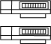
High level architecture iPort
Back to TOC
Airport
Desk
Kiosks
Internet
Mobile devices
Bagdrop
Tier 1: Local infra
iPort container. Renders HTML and interacts with peripheral devices
Various end user systems
BP
Tier 1: local infra
HTML
Third party and internet networks

Slide 5
High level architecture iPort
Back to TOC
Airport
Desk
Kiosks
Internet
Mobile devices
Bagdrop
Tier 1: Local infra
iPort container. Renders HTML and interacts with peripheral devices
Various end user systems
BP
Tier 1: local infra
HTML
Tier 2: iPort servers
Load control
Identity management
AHM data control
Passenger check-in
Gate handling
Standby handling etc
Third party and internet networks
iPort
ICI
Kiosk
Bagdrop
iPort web servers
Load control
Passenger handling
Aircraft data
Flight files
User id’s etc
Notes:
The

Slide 6
High level architecture iPort
Back to TOC
Airport
Desk
Kiosks
Internet
Mobile devices
Bagdrop
Tier 1: Local infra
iPort container. Renders HTML and interacts with peripheral devices
Various end user systems
BP
Tier 1: local infra
HTML
Tier 2: iPort servers
Load control
Identity management
AHM data control
Passenger check-in
Gate handling
Standby handling etc
Third party and internet networks
iPort
ICI
Kiosk
Bagdrop
iPort web servers
Load control
Passenger handling
Aircraft data
Flight files
User id’s etc
Aircraft data
Flight files
User id’s etc
Tier 3: Meridian
Services processed in TPF, published on web platform
Services are a mix of existing entries and specially created services
Internal webservices
Meridian: PNR updates, through check-in, seating etc.
XMLe
Meridian (TPF): Flight schedules, PNR data, all pax related data, seatmaps

Slide 7
High level architecture iPort
Back to TOC
Tier 4
Connectivity to External systems
Existing, standard interfaces
Local systems (airports, offices
And personal equipment)
Airport
Desk
Kiosks
Internet
Mobile devices
Bagdrop
Tier 1: Local infra
iPort container. Renders HTML and interacts with peripheral devices
Various end user systems
BP
Tier 1: local infra
HTML
Tier 2: iPort servers
Load control
Identity management
AHM data control
Passenger check-in
Gate handling
Standby handling etc
Third party and internet networks
Travelport ATL Data Center
iPort
ICI
Kiosk
Bagdrop
iPort web servers
Load control
Passenger handling
Aircraft data
Flight files
User id’s etc
Aircraft data
Flight files
User id’s etc
Tier 3: Meridian
Services processed in TPF, published on web platform
Services are a mix of existing entries and specially created services
Internal webservices
Meridian: PNR updates, through check-in, seating etc.
XMLe
Meridian (TPF): Flight schedules, PNR data, all pax related data, seatmaps
External systems (technology
Partners, commercial partners
Such as GDS’s)
Tier 4: other systems
Connectivity to External systems
Existing, standard interfaces
E-ticketing, PNR exchange, IATCI etc.
EDI, MQ, TTY, XML etc
1A
1S
DL
others

Slide 8
Tier 1 – Local infra
Back to TOC
Detailed explanation on Tier 1 topics:
Airport desk
Kiosk
Internet
Mobile
Bagdrop
Connectivity

Slide 9
Tier 1 - Local infra – Common use
Back to TOC
Airport
Desk
Kiosks
Internet
Mobile devices
Bagdrop
Airport desk – What is a CUTE platform?
Most of the larger airports (outside the USA) need to support a huge number of check-in and gate pc’s each with their own set of printers and scanners.
Also, they need to support multiple DCS’s (Departure Control System).
CUTE (Common Use Terminal Equipment) allows multiple applications to use the same hardware.
So, on a check-in desk, the end user can eg start Altea DC (Amadeus) for one carrier and start iPort to handle another airline.
However, they can never be active at the same time! Only one DCS is active on the workstation at any time.
CUTE is SITA’s version of common Use. They were the first ones to coin this phrase. The other providers use variations on this theme (Arinc for example has MUSE).
Each common use provider created its own Peripheral Manager. The PM connects to the peripheral devices (printers and scanners). This way it obscures the specific hardware interface from the DCS application.

Slide 10
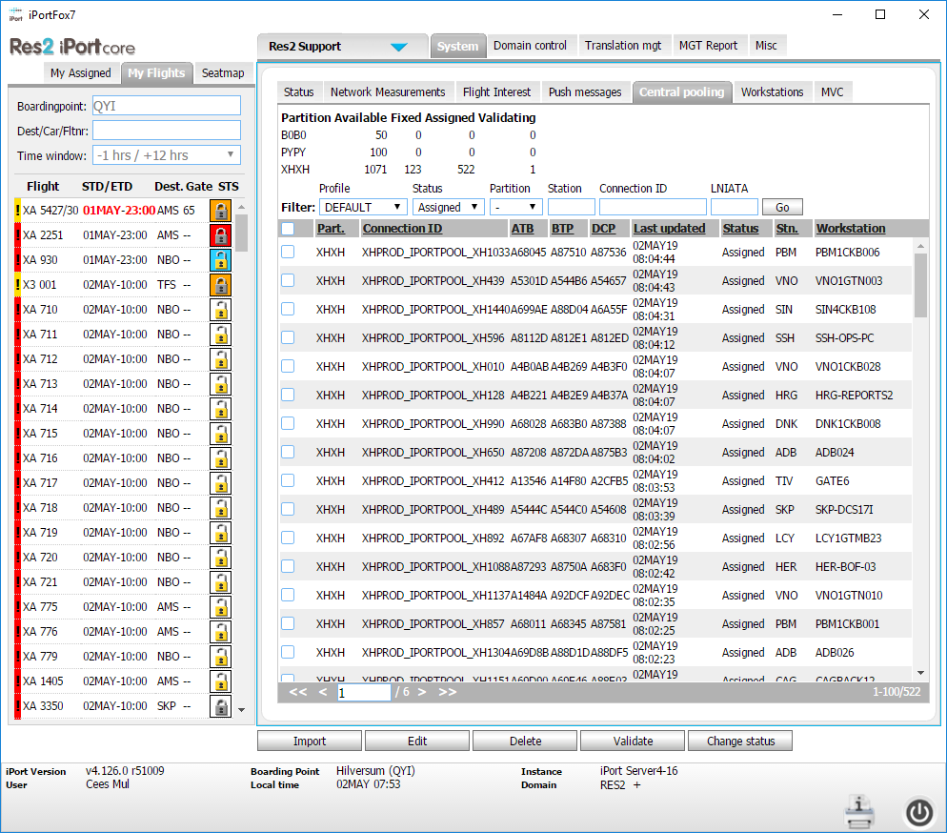
Tier 1 - iPortFox client logic
Back to TOC
Printing
When a user logs in to iPort, iPort requests an available printer session in the iPort database (tab central pooling in iPort).
QTPDEV uses this session name (connection ID) to set up sessions for the physical printers it found on the workstation (ATB, BTP, DCP). It connects to the e-gateway in ATL.
Once the session is established a pectab is sent (based on airport/carrier code). This pectab prepares the printer to print the fields at the correct positions.
Selecting the pectab is done automatically when a user selects a flight in iPort. A specific XMLe call is done which finds the correct pectab and pushes it to the printer.
Subsequent print data (boardingpass) will be processed by the printer according the positions it received in the pectab that is stored in its memory.
Cute versus non-cute (non-common use)
One specific version of QTPDEV communicates directly to the peripheral devices. It uses the AEA standard which defines the protocol to exchange data with the devices.
All other (cute) flavors use a specific API (Application Programming Interface) per CU platform to access the specific peripheral Manager.
Other considerations
We are currently developing iPortFox8 which is built in cooperation with Travsys.
IF8 will allow new types of devices (label printers) for non-common use airports and will have additional features, amongst others it will support CUPPS (Common Use Passenger Processing Systems).
Scanners and printers (local pc)
Simple AEA
SITA PM
Arinc PM
Non-CU:
QTPDEVT32
ULTRA PM (Peripheral Manager)
Resa PM
SITA CUTE
QTPDEVS32
Arinc Muse:
QTPDEVA32
Resa Crews
QTPDEVI32
ULTRA cuse
QTPDEVU32
iPortFox
Atlanta Data Center
216.113.141.251
216.113.133.250
e-gateway
iPort application
iPort servers
iPort
database
XMLe
(xx5)
Meridian

Slide 11
Tier 1 - iPortFox history
Back to TOC
Years 2006-2017
iPortFox6
Based on FireFox2 browser
Local config files, local printer pooling (trouble!)
Underlying middleware:
Qlogic for common use
HPM for non-common use
2013
Qlogic non-CU replaces HPM
Latest version iPortFox 6.2.7
2017
iPortFox6 decommissioned
Years 2017-…
iPortFox7
Based on Chromium browser framework
No more local configs (only for non-CU), central printer pooling
Underlying middleware:
Qlogic for all platforms
Reasons to replace IF6:
FF2 getting outdated
No TLS1.2 support (IATA demand)
Local config model not scalable and unreliable
Full roll out finished in 2018
Years 2019-…
iPortFox8
Based on Chromium browser framework
Support CUPPS, support non-AEA devices (label printers)
Underlying middleware:
Travsys TSCA platform. Have one executable for all platforms
Reasons to replace IF7:
Support non-AEA devices
Cooperation with Travsys more direct
Move towards encrypted printer data
Support CUPPS/ULTRA

Slide 12
Tier 1 - if we had CUPPS….
Back to TOC
If we had CUPPS
The combination TSCA (TravSys Container Application) and iPort simplifies the iPort tier 1 landscape in a big way.
No more separate device driver applications.
We will remove the Travelport e-gateway and send data directly to iPort.
Scanners and printers (local pc)
Simple AEA
Supports all CU platforms + non-common-use
SITA API
Arinc API
Non-CU:
QTPDEVT32
Resa API
SITA CUTE
QTPDEVS32
ULTRA API
Arinc Muse:
QTPDEVA32
iPortFox 8
TSCA
Resa Crews
QTPDEVI32
ULTRA cuse
QTPDEVU32
iPortFox
Atlanta Data Center
216.113.141.251
216.113.133.250
e-gateway
iPort application
iPort servers
iPort
database
XMLe
(xx5)
Meridian

Slide 13
Tier 1 - Local infra – Kiosk application
Back to TOC
Airport
Desk
Kiosks
Internet
Mobile devices
Bagdrop
Kiosk application
The iPort kiosk application is a web based application that is designed to run on the IATA CUSS (Common Use Self Service) platform.
Each airline customer can have their own lay-out (different style sheet).
Java is used to communicate with the CUSS API (to communicate with printers and scanners).
iPort CUSS kiosk is active on multiple platforms: SITA CUSS, Arinc CUSS, IER, Materna.
Functionality is a subset of what iPort provides:
Retrieve booking, check-in, change seat, print documents etc.
Select Detailed kiosk information for more info.

Slide 14
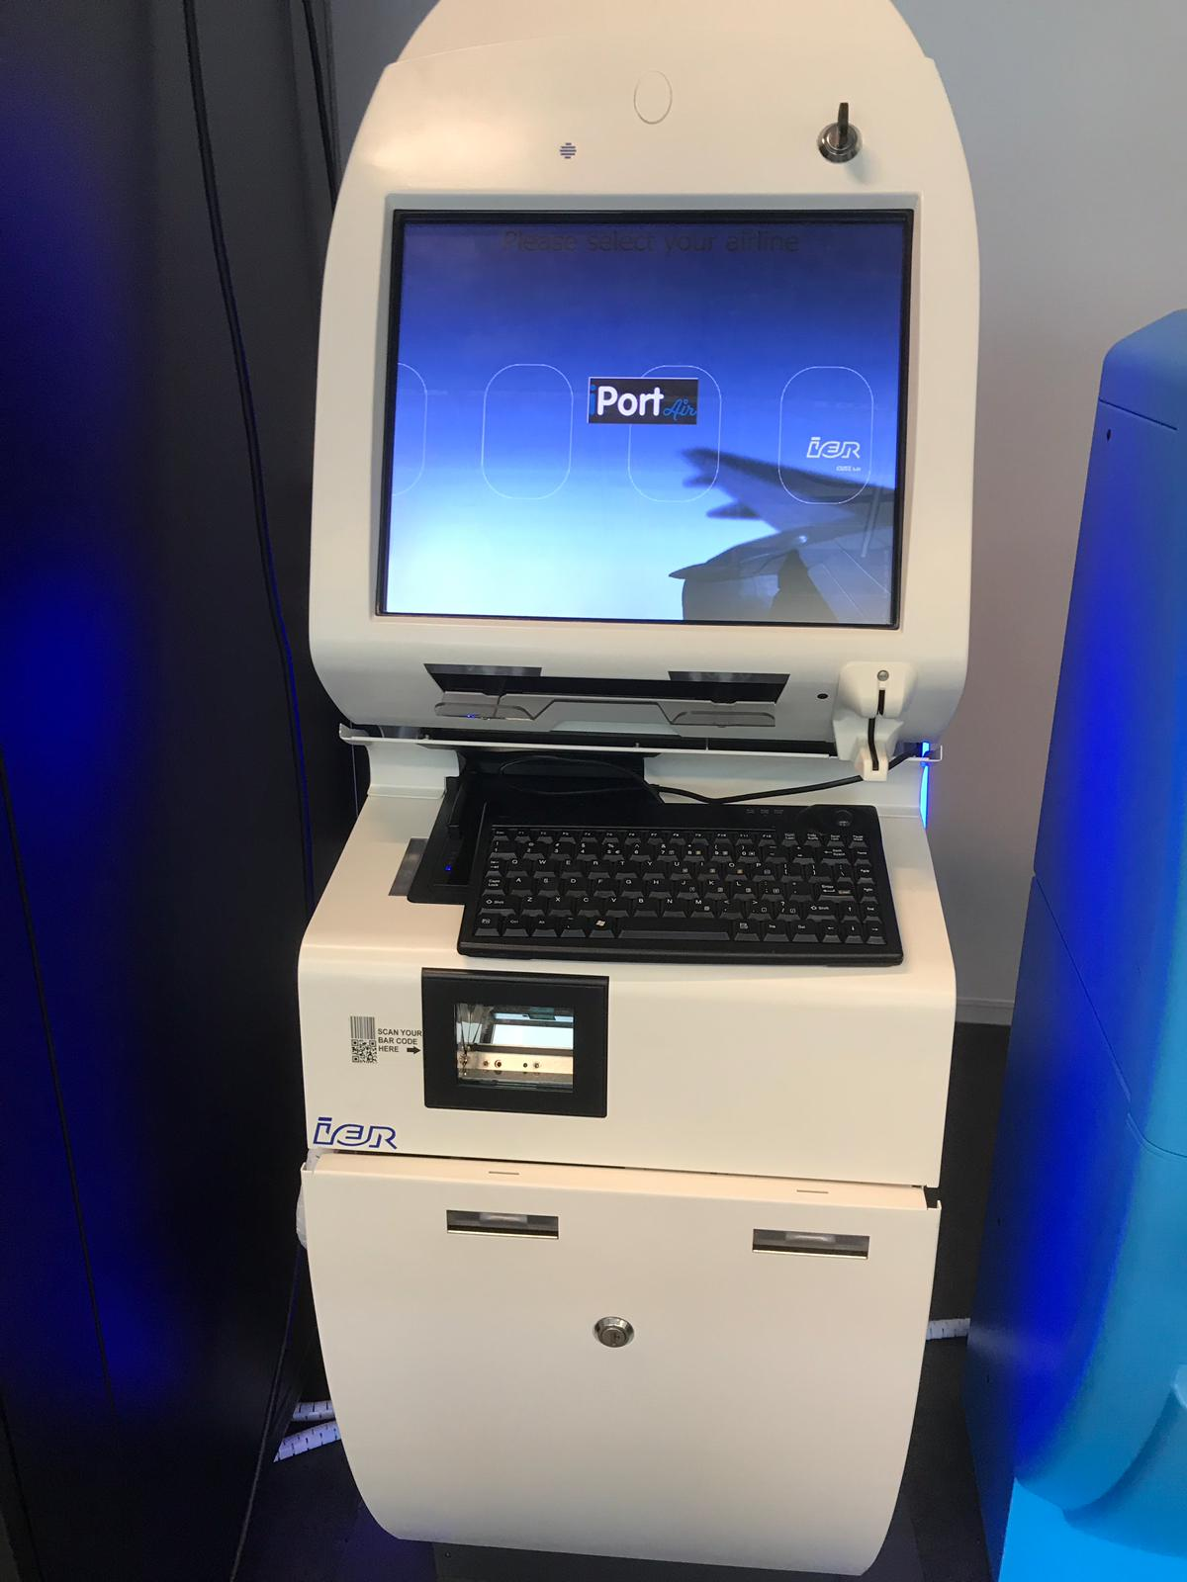
Tier 1 - iPort CUSS kiosk
Back to TOC
The iPort CUSS application is a web application that uses the built in browser capability of the kiosk
Scanners and printers (CUSS kiosk)
The CUSS API library is downloaded from the server when the application is started up.
The CUSS layer obscures the hardware specifics from the application.
Certification required for all platforms.
Many services in Meridian are re-used (also used by iPort desktop app and ICI). E.g. seatmap.
Only one IP address required, printer data is sent via query /reply streams
The kiosk application is multilingual. The various languages are maintained in resource files. Translations are usually provided by the customer.
CUSS API (Java)
Web browser
Atlanta Data Center
216.113.133.250
iPort CUSS application
iPort servers
iPort
database
XMLe
(xx7)
Meridian

Slide 15
Tier 1 - Local infra – Internet
Back to TOC
Airport
Desk
Kiosks
Internet
Mobile devices
Bagdrop
Internet
iPort is accessible via internet, but is not designed for a random browser.
Some customers use iPort on a tablet. This works, but it does create a security risk. We prefer that users use the iPortFox container since we can control the presentation of the application.
Internet check-in IS designed to work on any commonly used browser and various screen sizes.
Internet Check-in
Some of our airline customers use iPort web check-in (or ICI, Internet Check-in).
ICI is a separate iPort application which offers a subset of the total iPort functionality: check-in, change seat, fill in APIS, print boarding pass (or create electronic BP).
An airline can order its own ‘branding’. Color schemes and logo’s, but the business logic is similar for all. There is only one iPort ICI application, but various presentations.

Slide 16
Tier 1 - iPort Internet check-in
Back to TOC
The iPort Internet check in application is a web application that runs in the Atlanta data center
PC anywhere
Airlines typically create their own ‘drop through’ to access the iPort ICI application. Or it is framed in on the airline’s website.
The ICI application allows either a PDF formatted boarding pass or an Apple electronic boarding pass.
Web browser
Internet
Atlanta Data Center
216.113.133.250
iPort ICI application
iPort servers
iPort
database
XMLe
(xx6)
Meridian

Slide 17
Tier 1 - Local infra – Mobile devices
Back to TOC
Airport
Desk
Kiosks
Internet
Mobile devices
Bagdrop
Mobile devices
The ICI application is designed to work on mobile devices using a responsive design.
All iPort web based applications work on a mobile device, but are not specifically designed for it.

Slide 18
Tier 1 - Local infra – Bagdrop -1
Back to TOC
Airport
Desk
Kiosks
Internet
Mobile devices
Bagdrop
Bagdrop solutions
There are quite a few companies that provide solutions for automated bag drop.
SITA, Arinc, Materna, BBC all have their own solutions. The process usually consists of the following 3 services:
Identify passenger (boardingpass scan), response is the passenger data.
Addbaggage. The system checks if the added baggage fits within the baggage limitation of the passenger and creates a bagtag number.
Commitbag. This is where the baggage is sent to the conveyer belt, and a BSM is sent to the baggage system.
So, iPort does not have a ‘local’ bagdrop application, but allows third party bagdrop systems to access iPort.
The airport overview sheet on Sharepoint shows where bagdrop is active and which provider is present.

Slide 19
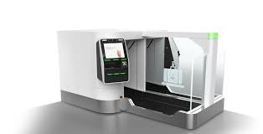

Tier 1 - Local infra – Bagdrop - 2
Back to TOC
Bagdrop hardware
An ICM bagdrop device
Bagdrop application
1.Identify passenger
2.Addbag
3.Commit
network
The interaction with iPort is fairly straightforward.
Only 3 steps.
The bagdrop device takes care of printing/formatting baggage labels based on iPort provided data.
Presentation services (including language support) are done by the bagdrop application. The other 3 iPort applications are web based, and have their own presentation layer.
Atlanta Data Center
216.113.133.250
iPort Bagdrop application
iPort servers
iPort
database
XMLe
(xx7)
Meridian

Slide 20
Tier 1 - iPort connectivity -1
Back to TOC
Most larger airports contract a common use provider to manage the airport IT infrastructure (meaning: Network, workstations, printers, scanners etc.).
There are a limited number of Common use airport IT providers:
SITA – system name CUTE (Common Use Terminal Equipment)
Arinc – Muse
RESA – Crews
Less prominent: Ultra, AirIT, Travsys
Some airports decide to maintain their own IT infrastructure, which we call ‘non-common use’ or ‘native’.
SITA and Arinc have their own, worldwide networks, RESA has not.
Res2 has ‘umbrella’ contracts with both Arinc and SITA and uses these connections when possible. Each airport that is contracted needs to be connected to the Atlanta data center.
There are alternatives to SITA and Arinc networks (next page).

Slide 21

Tier 1 - iPort connectivity -2
Back to TOC
Resa airports
airport
CUTE
airport
1
airport
Overview of connection options.
SITA:
Standard work order process
Standard network contracts (Community Connect DCS, formerly known as Express IP) per connected airport.
Arinc:
Standard work order process
Standard network contracts (Avinet) per connected airport.
Fastweb
Contracted by our partner Arcdata, mainly Italian Resa airports
Colt
Contracted to connect a number of French Resa airports
Internet
Sometimes, no other options than internet are possible
Resa
Has no own network, so is connected through a variety of network solutions.
1
airport
CUTE
airport
2
1
Resa airports
2
2
Arinc worldwide
network
1
airport
CUTE
airport
1
SITA worldwide
network
2
airport
CUTE
airport
airport
1
1
2
airport
airport
2
1
Resa airports
CUTE
airport
3
1
1
airport
1
2
ATL Sita routers
ATL Arinc routers
airport
CUTE
airport
airport
1
1
Fastweb
(Italy)
2
1
2
airport
1
PATL1847/PATL1848
2
airport
4
Ipsec VPN
2
1
1
ATL TP routers
airport
airport
Colt
(France)
2
1
2
airport
1
2
airport
iPort infrastructure
2
1
Resa airports
Legend
Local iPortFox 7 installation
Local routers subnets
ATL router changes
ATL 1P router changes
airport
Airport
Resa airports
Internet
Airport
Airport
Airport
2
1

Slide 22
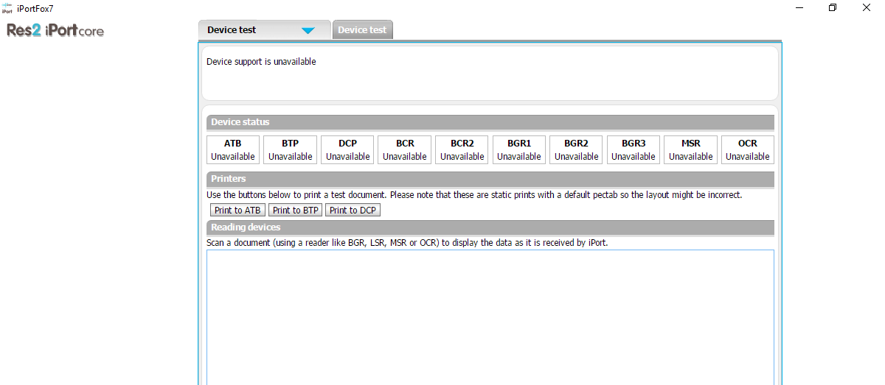
The implementation process
Back to TOC
Implementation is usually the activation of one or more airports on request of customers.
Per airport a number of steps need to be done (high level, details can be found in Airport_activation_iPortv4(2018).docx)
Determine if Common Use airport or not, and what type of common use (Sita, Arinc etc.)
Determine what type of connectivity is available.
Order connection for the specific airport. This can sometimes be easy, and sometimes extremely cumbersome.
In most cases paperwork is required to formally order the connection.
There is also a commercial aspect. SITA has fairly rigid pricing, others can vary widely, often depending on local parties that are involved in the process.
There is usually an OTC (One Time Charge) and a monthly fee.
Establishing the connection is the next step. This again, differs per provider. SITA has a very closed network, so every airport in the network needs to be defined in the ATL routers (the IP ranges need to be ‘advertised’).
Once iPort is installed, the periphal devices can be tested using the ‘device test’ page in iPort.
The above refers to the standard check-in/gate counters. Often, we get the request to provide CUSS kiosk functionality, or bagdrop interfaces.
Other dependencies:
Baggage routing (BSM), Domain settings, Security messaging set-up, pectab layouts, training.
The airport also needs to be set-up in Meridian (City Q table). This can be done directly in iPort.

Slide 23
Tier 2
Back to TOC
Detailed explanation on Tier 2 topics:
The iPort Servers
All 4 iPort applications were designed and created by Res2
iPort itself, web check-in, kiosk and bagdrop have many interactions with Meridian
Load control is more independent and has its own large AHM database. It does use flight schedules, seat maps and passenger/bag numbers from Meridian

Slide 24
Tier 2 - iPort servers – situation 2019
Back to TOC
The load balancer
distributes user sessions over the 4 servers.
If one server drops out or fails, the other 3 take over.
translates the HTTPS encryption into HTTP.
HTTPS: Hypertext Transfer Protocol over SSL.
SSL: Secured Sockets Layer (this requires a certificate on the pc)
iPort transaction servers
iPort agent servers
External networks
HTTPS
HTTP
216.113.133.250
Load balancer
HTTP
Windows server
2016
Windows server
2016
iPort
iPort
iPort
iPort
iPort ICI
iPort ICI
iPort ICI
iPort ICI
The iPort servers
The iPort transaction servers receive transactions for all 4 iPort applications.
The iport servers compress the data that is sent to the iPortFox client. This is done to reduce network usage.
No customer sessions on the 2 agent servers. They process ‘batch’ type of data. Time initiated transactions and back-end processing such as sending of messages
All 6 iPort servers (windows) connect to TPF via MQ/XMLe
New release of the iPort applications every 3 weeks
iPort kiosk
iPort kiosk
iPort kiosk
iPort kiosk
iPort agent
iPort agent
iPort bagdrop
iPort bagdrop
iPort bagdrop
iPort bagdrop
MQ client
MQ client
MQ client
MQ client
MQ client
MQ client
XMLEPN03
XMLEPN04
XMLEPN01
XMLEPN02
XMLEPN05
XMLEPN06
wblchppnas0170v
wblchppnas0180v
wblchppnas0050v
wblchppnas0060v
wblchppnas0190v
wblchppnas0200v
MQ/XMLe
TPF (Meridian)

Slide 25
http://pn-outbound-proxy.tvlport.com
Tier 2 - iPort servers – situation 2019
Back to TOC
The load balancer
distributes user sessions over the 4 servers
If one server drops out or fails, the other 3 take over
translates the HTTPS encryption into HTTP
iPort transaction servers
iPort agent servers
Payment providers,
Traveldoc/others
216.113.133.250
Load balancer
W2016
W2016
iPort
iPort
iPort
iPort
The iPort servers
The iPort transactio servers receive transactions for all 4 iPort applications.
The iport servers compress the data that is sent to the iPortFox client. This is done to reduce network usage.
No customer sessions on the 2 agent servers. They process ‘batch’ type of data. Time initiated transactions and back-end processing such as sending of messages
All 6 iPort servers (windows) connect to TPF via MQ/XMLe
New release of the iPort applications every 3 weeks
iPort has connections to payment providers and other third parties (iSales for airlines)
iPort ICI
iPort ICI
iPort ICI
iPort ICI
iPort kiosk
iPort kiosk
iPort kiosk
iPort kiosk
iPort agent
iPort agent
iPort bagdrop
iPort bagdrop
iPort bagdrop
iPort bagdrop
MQ client
MQ client
MQ client
MQ client
MQ client
MQ client
XMLEPN03
XMLEPN04
XMLEPN01
XMLEPN02
XMLEPN05
XMLEPN06
wblchppnas0170v
wblchppnas0180v
wblchppnas0050v
wblchppnas0060v
wblchppnas0190v
wblchppnas0200v
Travelport proxy server
MQ/XMLe
http://pn-outbound-proxy.tvlport.com
TPF (Meridian)

Slide 26
Tier 2 - iPort servers – Database -1
Back to TOC
The iPort database is an SQL cluster
Connected to iPort via network (TCP/IP)
It has a primary and secondary instance which are continuously updated (failover)
Main components of that database:
All AHM data
The flight files (detailed information per flight)
The routing tables (TTY and email addresses for messaging)
Carrier settings (unique values per carrier)
Historical data
Domain/userid information
Passenger and flight data is mainly retrieved from Meridian. This happens seamless towards end-users. iPort ‘merges’ data coming from various sources and presents it as one
Various log files are maintained. Web sessions, exceptions, XMLe logging. XMLe logging is shown in the iPort portal. The data is logged on the iPort servers and automatically transferred to the server in de Meern
Slide 26

Slide 27
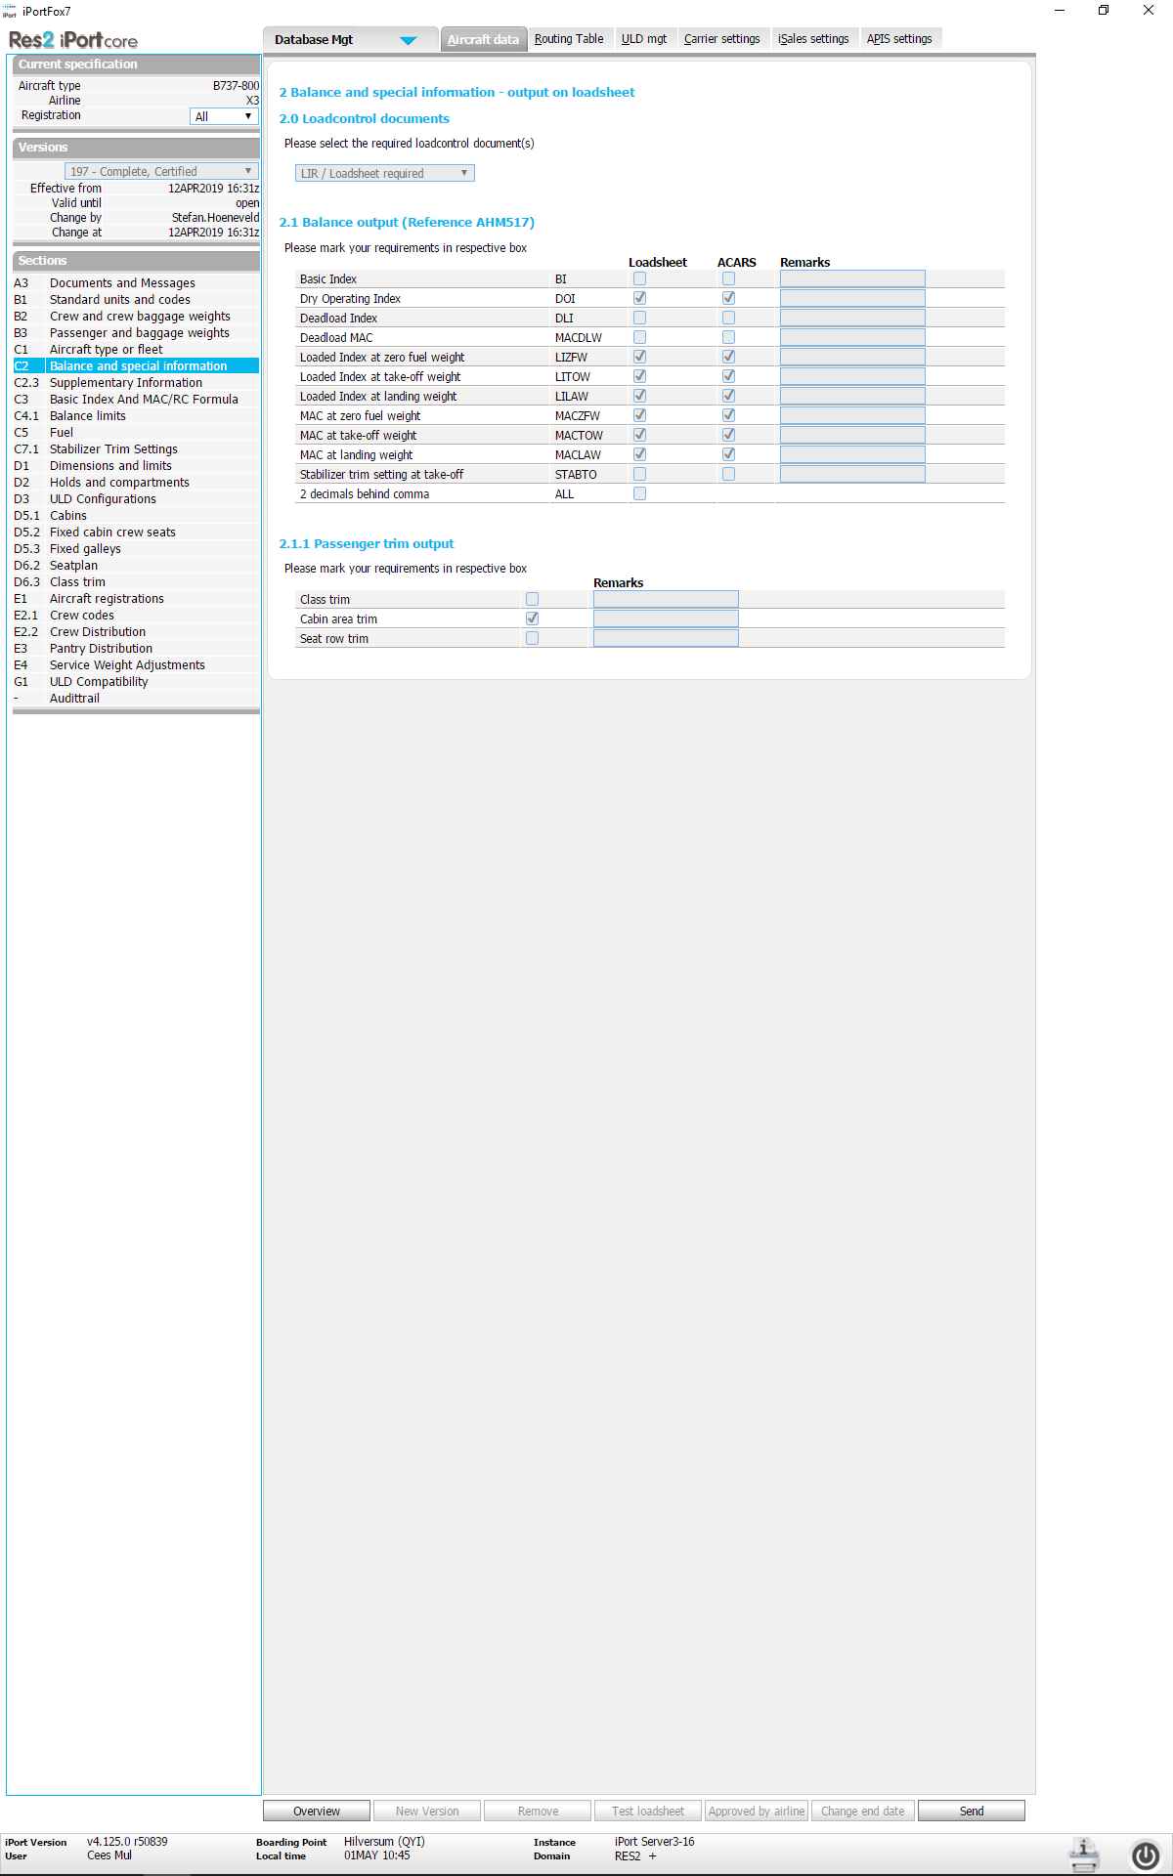
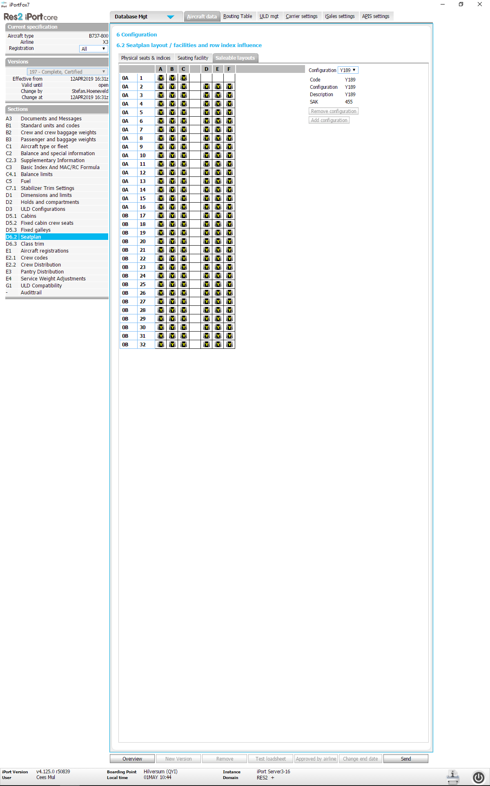
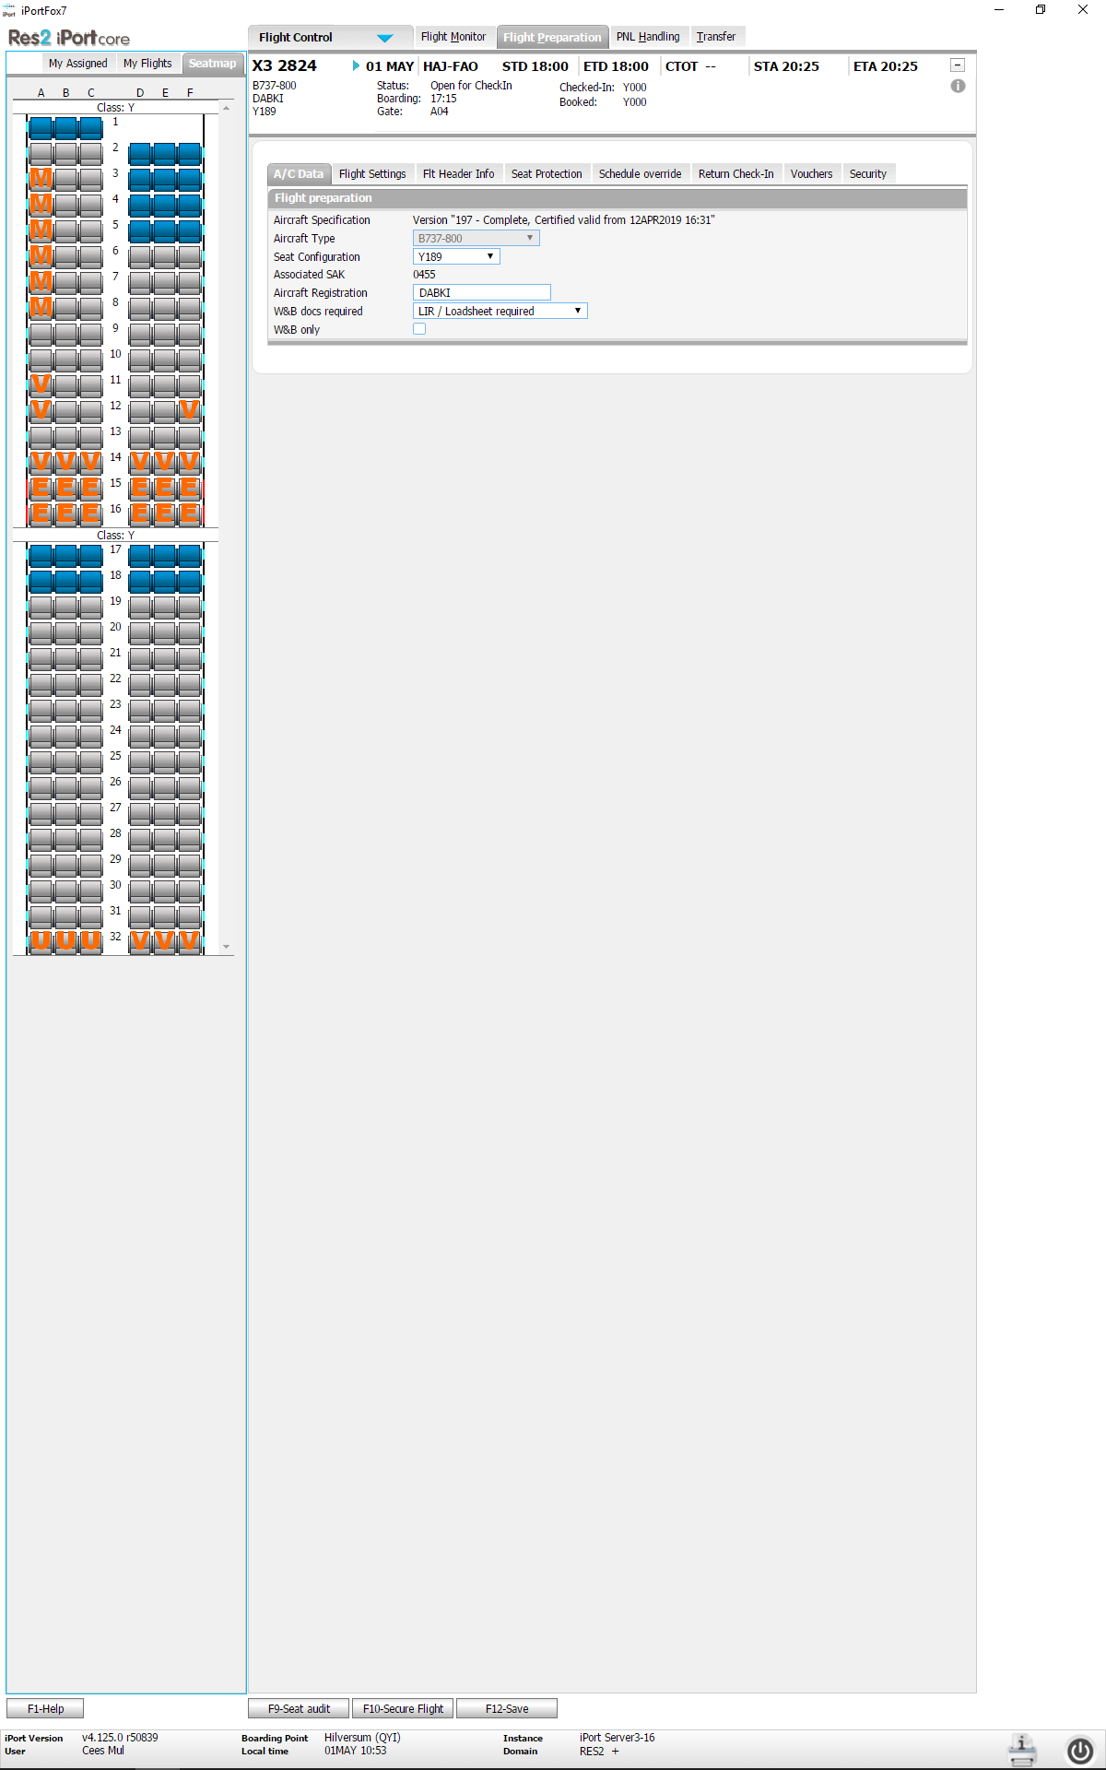
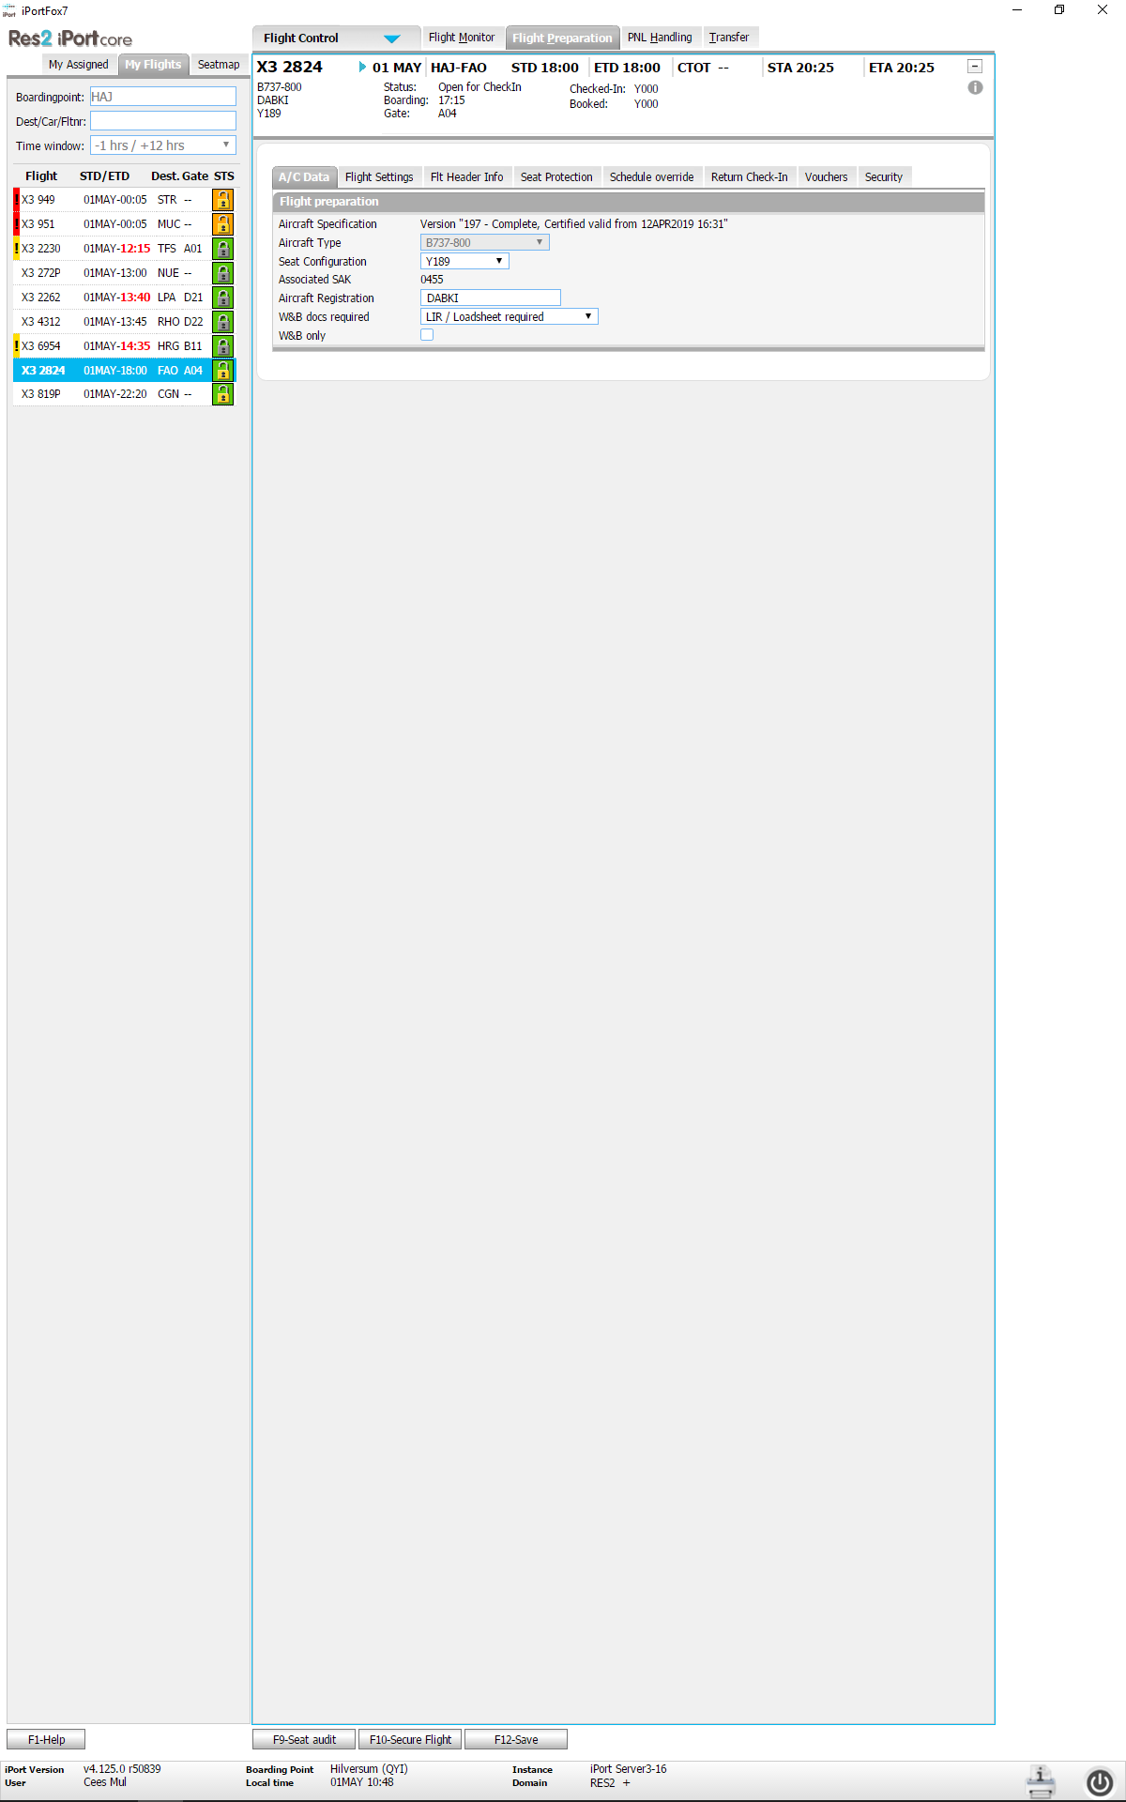
Tier 2 - iPort servers – Database -2
Back to TOC
AHM data
Aircraft Handling Manual: All data that defines the necessary settings to perform load control on an airplane, eg: Aircraft type, dimensions, seatmap, fuel data, location of galleys, size and location of compartments etc.
In order to handle a load control flight, the associated aircraft MUST be in the iPort AHM database and MUST have the ‘certified’ status (approved test loadsheet by the airline).
AHM data resides in the iPort SQL database.
Seatmap: once an aircraft is ‘attached’ to a flight, a seatmap in Meridian is created. This is a copy of the data from the seatplan in the AHM files. Passengers are indexed on the Meridian seat map, not on the iPort seatmap.
Interaction with Meridian occurs when actual numbers are required by load control (passenger and baggage data).
The rest of the data is strictly SQL
SAK: Seat Allocation ‘K’onfiguration
Slide 27

Slide 28
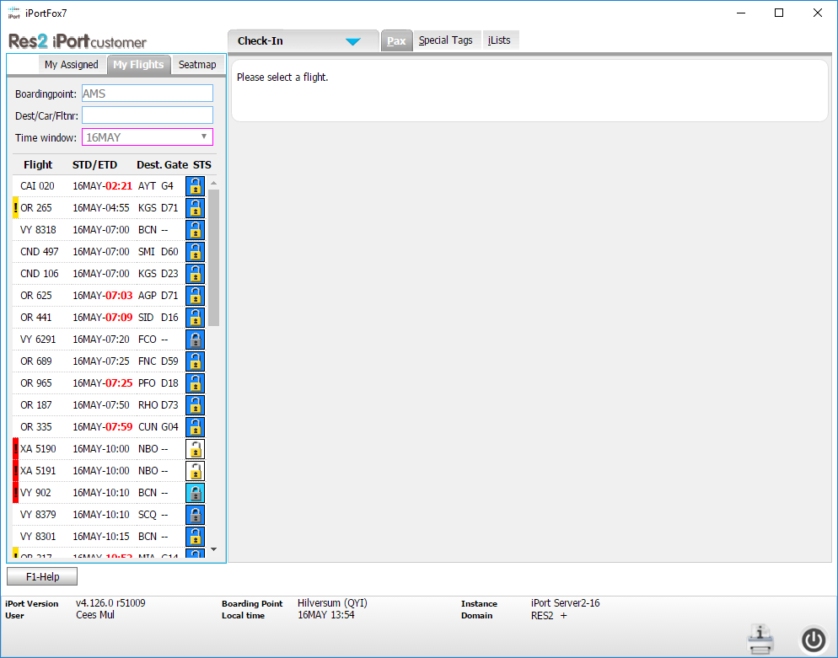
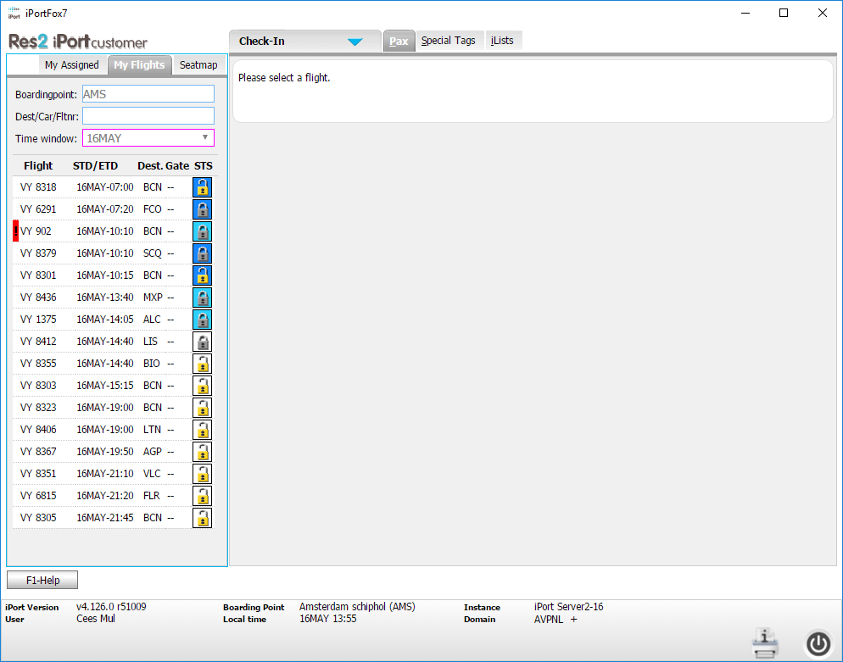
Tier 2 – The domain structure
Back to TOC
How does the domain structure relate to the iPort database?
A ‘domain’ is a database entity per customer
The essential database content (flight files, AHM data) is a single database.
The domain ‘filters’ determine the view and authorisations for a specific domain.
The User id’s are defined in a specific domain and are involved in the next level of filtering.
Example: here is a view on Amsterdam from the Res2 domain.
Followed by a view on Amsterdam from the Aviapartner domain.
Slide 28

Slide 29
Tier 2 – The domain structure
Back to TOC
How does the domain structure relate to the iPort database?
Typically read/write access
Typically read only
TUI users
Ground handler X
Domain definitions and rules
Domain/user based filtering
Read/write access
AHM
TUI
Flights
Neos
AHM
VJ
Flights
TUI
AHM
Neos
Flights
VJ
iPort operational database
Slide 29

Slide 30
Tier 3
Back to TOC
Detailed explanation on Tier 3 topics:
Meridian
XMLe
Slide 30

Slide 31
Tier 3 - Meridian
Back to TOC
Meridian is an application (dealing with passenger handling) operating on IBM’s TPF platform (Transaction Processing Facility).
More info: https://en.wikipedia.org/wiki/Transaction_Processing_Facility
Meridian is accessed via an MQ hub. Primary and secondary. So also has a fail-over
Data is pure XML. This is the data exchanges that you see in the log files on the portal
iPort formats XML SOAP requests and sends the requests to TPF.
The request will be processed by any of the 8 TPF CPU’s. The CPU id can be seen in the log files on the portal
The Meridian application has many tasks:
PNL processing, Flight Agreements, PNR data, IATCI (send and receive), E-ticketing, seating, messaging etc.
Load balancer
iPort servers
This is the data exchange you see in the log files on the portal!
MQ hub 1
MQ hub 2
TPF A
TPF B
TPF C
TPF D
TPF E
TPF F
TPF G
TPF H
XMLe
XMLe
XMLe
XMLe
XMLe
XMLe
XMLe
XMLe

Slide 32
Tier 3 - Meridian – main functionalities
Back to TOC
FAT agreements (Flight Association Table)
A flight agreement indicates that a flight can be processed in Meridian (PNL’s will only be accepted for flights that have a FAT agreement in the TPF database).
There are multiple types of flight agreements:
E-agreements Allows groundhandling for scheduled (OAG) flights.
G-agreements Allows groundhandling for non-scheduled flights (so defines the schedule).
F-agreements Code share related.
H-agreements Defines IATCI connections.
Flight schedules
Since Meridian is also a GDS, its database contains many flights that are published by OAG (Official Airline Guide). OAG gathers all schedules from the airlines that are associated and sends the info to GDS’s and airlines. This database is refreshed 3 times a week in Meridian.
Relation with flights in iPort
The iPort agent process scans the agreements database every night and creates active flights in iPort (a flight file in the SQL database). Thus, a new day of flights is created nightly. iPort has an active date range of 7 days. It creates new flights 6 days before departure based on the FAT data in Meridian.
PNR’s
Passenger Name Records are created by the PNL/ADL processing, or can be created as NOREC. They are indexed from a flight record in Meridian. All iPort passenger views are based on the PNR.
Load balancer
iPort servers
MQ
MQ
TPF A
TPF B
TPF C
TPF D
TPF E
TPF F
TPF G
TPF H
XMLe
XMLe
XMLe
XMLe
XMLe
XMLe
XMLe
XMLe

Slide 33
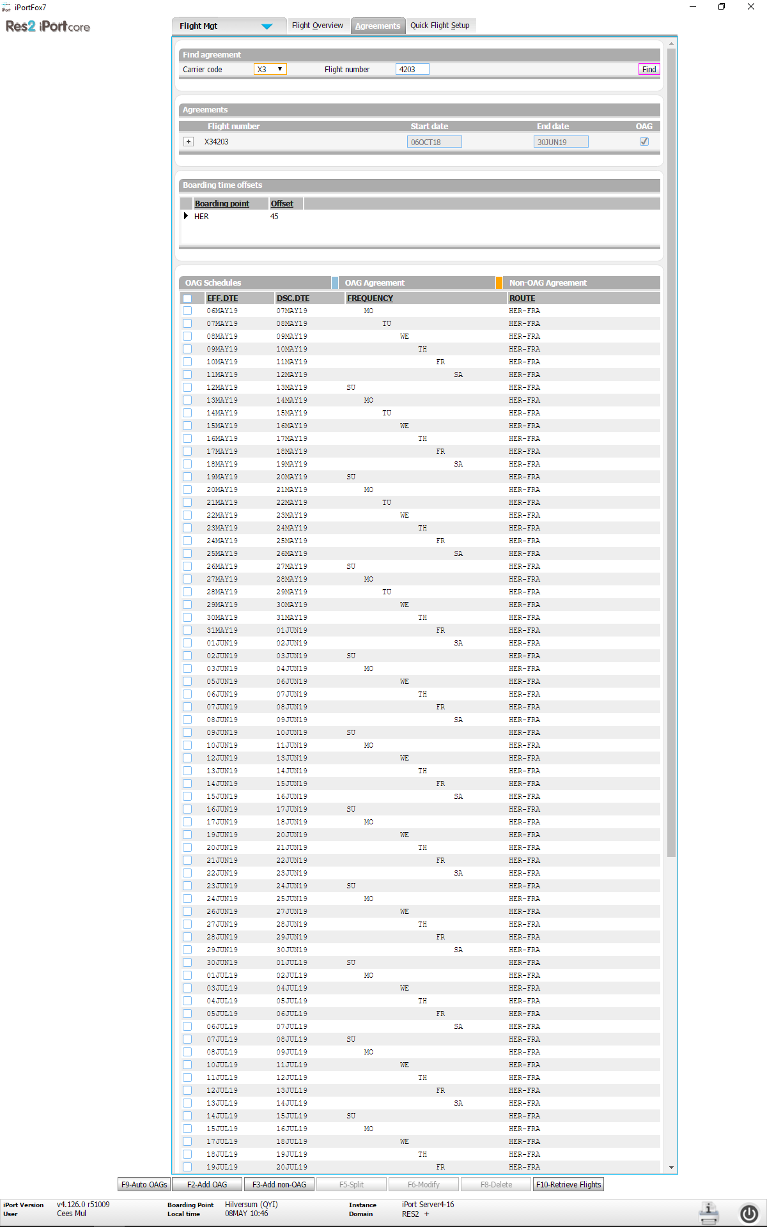
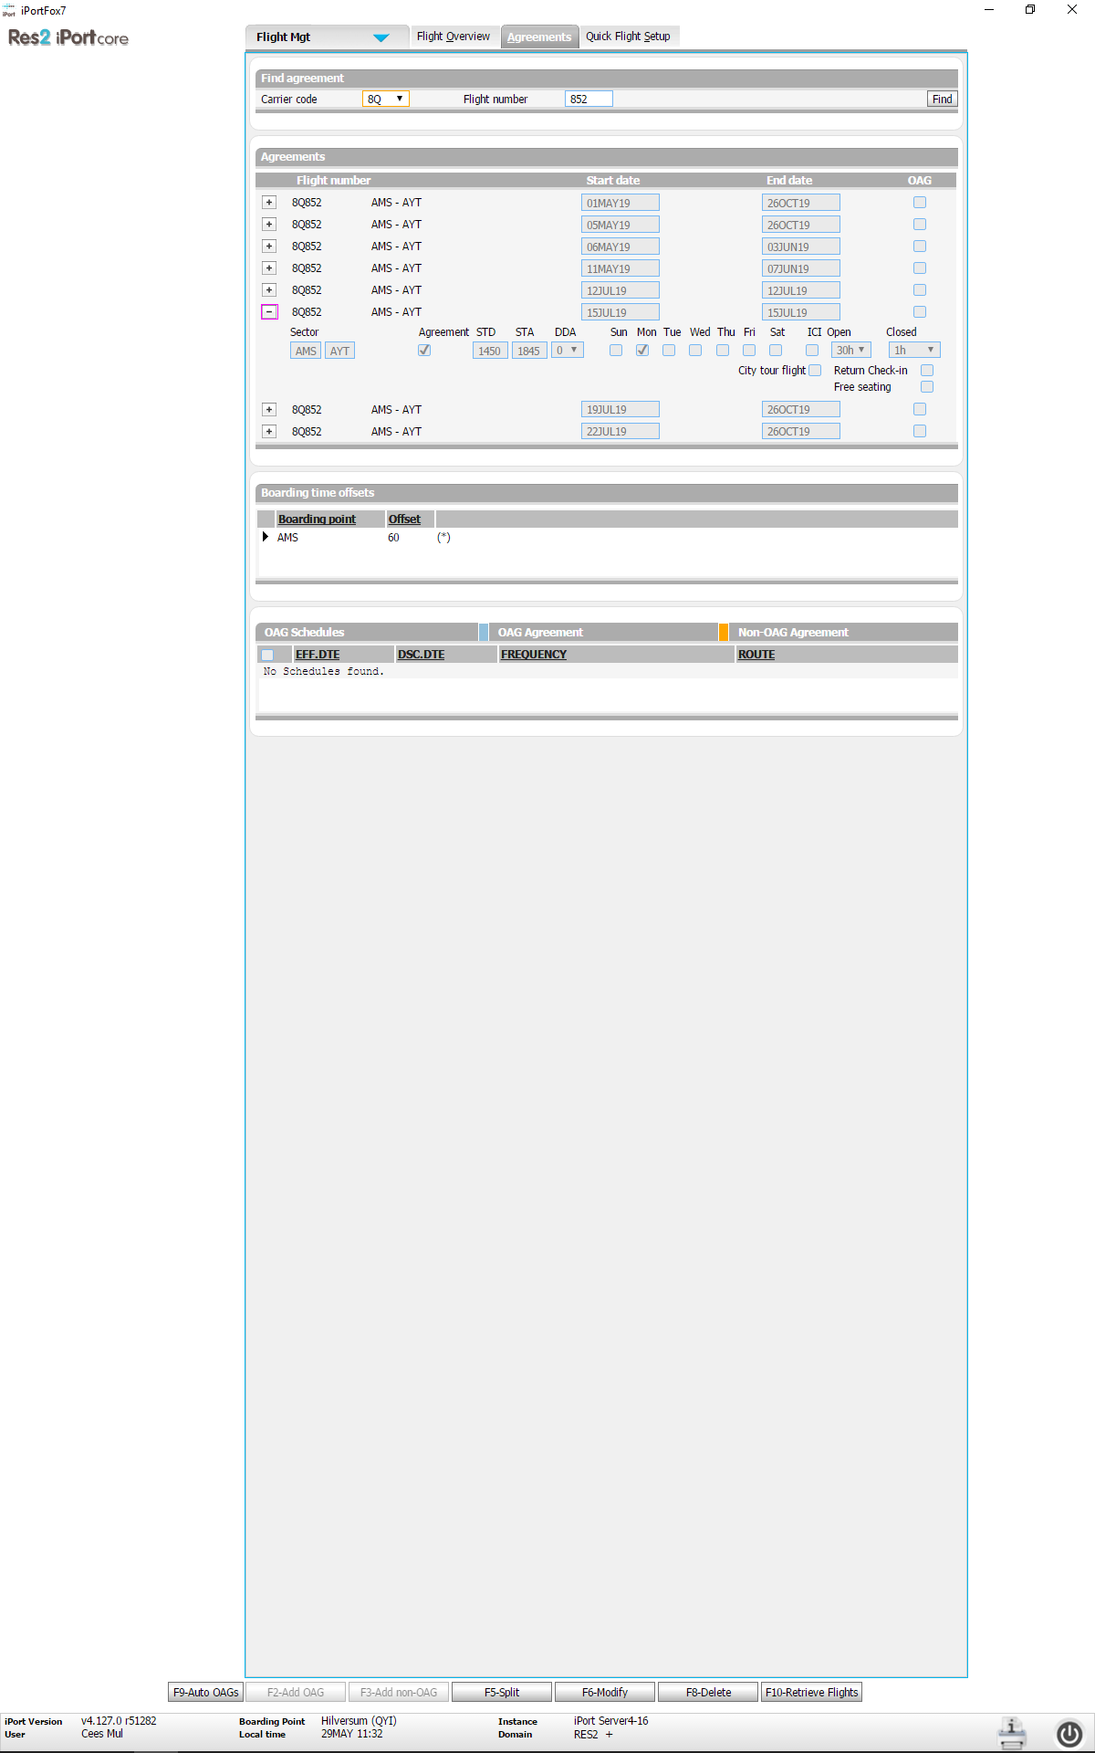
Tier 2/3 – Flight creation
Back to TOC
How are flights created in iPort?
Step 1: create the agreement. This can be done either manually or automated.
Manually:
An agreement is created
Either G-agreement (no OAG schedule present)
Or E-agreement (based on OAG schedule in Meridian)
Atlanta Data Center
1. Carrier/station settings
Result of 1c: Auto-e data
Result of step 2: Flight files
iPort Agent servers
Automated (currently only OAG)
The iPort agent process reads the flights departing from a specific airport (loops through all airports)
iPort agent checks if the airport/airline combination is an auto–e candidate based on carrier/station settings.
Iport agent finds all relevant flights in the OAG database
Results are stored in the iPort database
Next process: Loop through all items created in step 1. Check if the agreement already exists. If not yet existing, it creates a 5 day agreement for the flight (this is all in Meridian)
iPort database
1. Abstract: determine which agreements need to be created and store result in iPort DB
2. Abstract: create 5 day agreements in Meridian. This allows GH’ing for these flights
Abstract: Create flights in iPort based on data present in e-agreements in meridian (auto-E and manual)
Meridian database
Result of 2.Agreements DB
OAG flights
Step 2: create the flight file in iPort
The flight files in iPort are created by a daily job that runs on the iPort agent servers. The iPort agent reads all agreements for a specific day (E and G) and sets up flight records in iPort (so they can be used by the end-users)
Meridian

Slide 34
Tier 2/3 - Meridian - XMLe
Back to TOC
Load balancer
XMLe (XML enabler) is used for interaction between iPort and TPF. It can be viewed as the ‘glue’ between iPort and Meridian.
XMLe is a software package owned by Res2, and implemented on TPF. We purchased it from KLM (Cees developed it during his time in KLM) in the early days of the project.
It allows us to ‘abstract’ detailed functions inside TPF (such as boarding, check-in seatmap etc.
iPort calls business functions that relate 1 to 1 to a script (service) that resides on TPF
iPort issues a XML/SOAP (Simple Object Access Protocol) which is sent to TPF via IBM’s MQ (Message Queuing).
Message Queuing is a standard that is available on most major platforms, so provides a good method to connect systems in an efficient flexible way.
We will not discuss SOAP and MQ in detail in this session…
TPF contains a big library of XMLe services which can also be accessed via the script editor tool.
iPort servers
This is the data exchange you see in the log files on the portal!
MQ
MQ
TPF A
TPF B
TPF C
TPF D
TPF E
TPF F
TPF G
TPF H
XMLe
XMLe
XMLe
XMLe
XMLe
XMLe
XMLe
XMLe
‘Pseudo’ city codes
In order to distinguish between the various access channels (check-in desk, kiosk etc.), iPort
uses pseudo city codes that are associated with the main code (Keflavik has main code KEF, and uses KE5 for counter check-in, KE6 for web check-in and KE7 for kiosk/bagdrop.
Airline code translation
Meridian only supports 2 letter airline codes, but there are translate routines that translate a 3 character airline code into 2 and vice versa. If iPort shows CND (Corendon, the flight in Meridian is actually stored with its 2 letter code.

Slide 35
Tier 2/3 - Meridian –XMLe example
Back to TOC
Request
MQ server
Pseudo
City code
2019-04-18 00:00:00,523UTC DEBUG RES2.XMLE 3349 WK051-18APR-HKT BAGS XMLE-Request Queue:Main-PN05-Primary Script:FLTSEATMP3 CorrelationId:414D5120584D4C45504E303520202020F27EA95C2524C7C9 <SoapEnv:Envelope xmlns:SoapEnv="http://schemas.xmlsoap.org/soap/envelope/" xmlns:XMLEScript="http://www.Res2.nl/tpfscript/soap/headers/" SoapEnv:encodingStyle="http://schemas.xmlsoap.org/soap/encoding/">
<SoapEnv:Header/> <SoapEnv:Body> <XMLEScript:FLTSEATMP3 Group="FLT" Version="0" Partition="XHXH" City="HK5" City_org="HK5" signincode_org="64703B"> <signincode>64703B</signincode> <flightdata> <carcode>WK</carcode> <fltnr>51</fltnr> <fltdate>18APR</fltdate> <boardpoint>HKT</boardpoint> <destination>ZRH</destination> <depdate>18APR</depdate> </flightdata> <firstoffpoint>ZRH</firstoffpoint> <flightselection> <pnrinfo> <pnr>2JSVYN</pnr> <nbrofpaxinpnr xsi:nil="true" /> <bookingclass>Y</bookingclass> </pnrinfo> <flightdata> <carcode>WK</carcode> <fltnr>51</fltnr> <boardpoint>HKT</boardpoint> <destination>ZRH</destination> <depdate>18APR</depdate> <fltseqnr>1</fltseqnr> </flightdata> <islocal>Y</islocal> </flightselection> <showinf>N</showinf> </XMLEScript:FLTSEATMP3> </SoapEnv:Body> </SoapEnv:Envelope>
Associated response
2019-04-18 00:00:00,633UTC DEBUG RES2.XMLE 3349 WK051-18APR-HKT BAGS XMLE-Response Queue:Main-PN05-Primary Script:FLTSEATMP3 CorrelationId:414D5120584D4C45504E303520202020F27EA95C2524C7C9 Roundtrip:109ms Started:2019-04-18 00:00:00.523 Response:2019-04-18 00:00:00.633 PutDuration:0ms Result:<SoapEnv:Envelope xmlns:SoapEnv="http://schemas.xmlsoap.org/soap/envelope/" xmlns:XMLEScript="http://www.Res2.nl/tpfscript/soap/headers/" SoapEnv:encodingStyle="http://schemas.xmlsoap.org/soap/encoding/">
<SoapEnv:Header/> <SoapEnv:Body> <XMLEScript:FLTSEATMP3Response Duration="98" Lniata="6AA689" Cpuid="E"> <comp><cos>Y</cos><code>B</code><s>01A:$:w:L</s><s>01B:$:a:L</s><s>01D:$:a:L</s><s>01E:$:c:L</s><s>01F:$:c:L</s><s>01G:$:a:L</s><s>01J:R:a:L</s><s>01K:$:w:L</s><s>02A:$:w:L</s><s>02B:$:a:L</s><s>02D:$:a:L</s><s>02E:$:c:L</s><s>02F:Z:c:L</s><s>02G:$:a:L</s><s>02J:$:a:L</s><s>02K:$:w:L</s><s>03A:$:w:L</s><s>03B:$:a:L</s><s>03D:$:a:L</s><s>03E:$:c:L</s><s>03F:Z:c:L</s><s>03G:$:a:L</s><s>03J:$:a:L</s><s>03K:$:w:L</s><s>04A:$:w:L</s><s>04B:$:a:L</s><s>04D:$:a:L</s><s>04E:$:c:L</s><s>04F:$:c:L</s><s>04G:$:a:L</s><s>04J:$:a:L</s><s>04K:$:w:L</s><s>05A:$:w:L</s><s>05B:$:a:L</s><s>05D:$:a:L</s><s>05E:$:c:L</s><s>05F:$:c:L</s><s>05G:$:a:L</s><s>05J:$:a:L</s><s>05K:$:w:L</s><s>06A:$:w:L</s><s>06B:$:a:L</s><s>06D:$:a:L</s><s>06E:$:c:L</s><s>06F:$:c:L</s><s>06G:$:a:L</s><s>06J:$:a:L</s><s>06K:$:w:L</s><s>07A:$:w:L</s><s>07B:$:a:L</s><s>07D:$:a:L</s><s>07E:Z:c:L</s><s>07F:Z:c:L</s><s>07G:$:a:L</s><s>07J:$:a:L</s><s>07K:$:w:L</s><s>08A:$:w:L</s><s>08B:$:a:L</s><s>08D:$:a:L</s><s>08E:$:c:L</s><s>08F:$:c:L</s><s>08G:$:a:L</s><s>08J:$:a:L</s><s>08K:$:w:L</s><s>09A:$:w:L</s><s>09B:$:a:L</s><s>09D:$:a:L</s><s>09E:$:c:L</s><s>09F:$:c:L</s><s>09G:$:a:L</s><s>09J:$:a:L</s><s>09K:$:w:L</s><s>10D:$:a:L</s><s>10E:$:c:L</s><s>10F:Z:c:L</s><s>10G:$:a:L</s></comp><comp><cos>Y</cos><code>C</code><s>18A:$:w</s><s>18B:$:a</s><s>18D:$:a</s><s>18E:$:c</s><s>18F:$:c</s><s>18G:$:a</s><s>18J:$:a</s><s>18K:$:w</s><s>19A:$:w</s><s>19B:$:a</s><s>19D:$:a</s><s>19E:$:c</s><s>19F:$:c</s><s>19G:$:a</s><s>19J:$:a</s><s>19K:$:w</s><s>20A:$:w</s><s>20B:$:a</s><s>20D:$:a</s><s>20E:$:c</s><s>20F:$:c</s><s>20G:$:a</s><s>20J:$:a</s><s>20K:$:w</s><s>21A:$:w</s><s>21B:$:a</s><s>21D:$:a</s><s>21E:$:c</s><s>21F:$:c</s><s>21G:$:a</s><s>21J:$:a</s><s>21K:$:w</s><s>22A:$:w</s><s>22B:$:a</s><s>22D:$:a</s><s>22E:$:c</s><s>22F:$:c</s><s>22G:$:a</s><s>22J:$:a</s><s>22K:$:w</s><s>23A:$:w</s><s>23B:$:a</s><s>23D:$:a</s><s>23E:$:c</s><s>23F:$:c</s><s>23G:$:a</s><s>23J:$:a</s><s>23K:$:w</s><s>24A:$:w</s><s>24B:$:a</s><s>24D:$:a</s><s>24E:$:c</s><s>24F:$:c</s><s>24G:$:a</s><s>24J:$:a</s><s>24K:$:w</s><s>25A:$:w</s><s>25B:$:a</s><s>25D:$:a</s><s>25E:$:c</s><s>25F:$:c</s><s>25G:$:a</s><s>25J:$:a</s><s>25K:$:w</s><s>26A:$:w</s><s>26B:$:a</s><s>26D:$:a</s><s>26E:$:c</s><s>26F:$:c</s><s>26G:$:a</s><s>26J:$:a</s><s>26K:$:w</s><s>27A:$:w</s><s>27B:$:a</s><s>27D:$:a</s><s>27E:$:c</s><s>27F:$:c</s><s>27G:$:a</s><s>27J:$:a</s><s>27K:$:w</s></comp><comp><cos>Y</cos><code>D</code><s>28D:$:a</s><s>28E:$:c</s><s>28F:$:c</s><s>28G:$:a</s><s>29A:$:w</s><s>29B:$:a</s><s>29D:$:a</s><s>29E:$:c</s><s>29F:$:c</s><s>29G:$:a</s><s>29J:$:a</s><s>29K:$:w</s><s>30A:$:w</s><s>30B:$:a</s><s>30D:$:a</s><s>30E:$:c</s><s>30F:$:c</s><s>30G:$:a</s><s>30J:$:a</s><s>30K:$:w</s><s>31A:$:w</s><s>31B:$:a</s><s>31D:$:a</s><s>31E:$:c</s><s>31F:$:c</s><s>31G:$:a</s><s>31J:$:a</s><s>31K:$:w</s><s>32A:$:w</s><s>32B:$:a</s><s>32D:$:a</s><s>32E:$:c</s><s>32F:$:c</s><s>32G:$:a</s><s>32J:$:a</s><s>32K:$:w</s><s>33A:$:w</s><s>33B:$:a</s><s>33D:$:a</s><s>33E:$:c</s><s>33F:$:c</s><s>33G:$:a</s><s>33J:$:a</s><s>33K:$:w</s><s>34A:$:w</s><s>34B:$:a</s><s>34D:$:a</s><s>34E:$:c</s><s>34F:$:c</s><s>34G:$:a</s><s>34J:$:a</s><s>34K:$:w</s><s>35A:$:w</s><s>35B:$:a</s><s>35D:$:a</s><s>35E:$:c</s><s>35F:$:c</s><s>35G:$:a</s><s>35J:$:a</s><s>35K:$:w</s><s>36A:$:w</s><s>36B:$:a</s><s>36D:$:a</s><s>36E:$:c</s><s>36F:$:c</s><s>36G:$:a</s><s>36J:$:a</s><s>36K:$:w</s><s>37A:$:w</s><s>37B:$:a</s><s>37D:$:a</s><s>37E:$:c</s><s>37F:$:c</s><s>37G:$:a</s><s>37J:$:a</s><s>37K:$:w</s><s>38A:$:w</s><s>38B:$:a</s><s>38D:$:a</s><s>38E:$:c</s><s>38F:$:c</s><s>38G:$:a</s><s>38J:$:a</s><s>38K:$:w</s><s>39A:$:w</s><s>39B:$:a</s><s>39D:$:a</s><s>39E:$:c</s><s>39F:$:c</s><s>39G:$:a</s><s>39J:$:a</s><s>39K:$:w</s><s>40A:$:w</s><s>40B:$:a</s><s>40D:$:a</s><s>40E:$:c</s><s>40F:$:c</s><s>40G:$:a</s><s>40J:$:a</s><s>40K:$:w</s><s>41A:$:w</s><s>41B:$:a</s><s>41D:$:a</s><s>41E:$:c</s><s>41G:$:a</s><s>41J:$:a</s><s>41K:$:w</s><s>42A:$:w</s><s>42B:$:a</s><s>42D:$:a</s><s>42E:$:c</s><s>42G:$:a</s><s>42J:$:a</s><s>42K:$:w</s><s>43A:$:w</s><s>43B:$:a</s><s>43D:$:a</s><s>43E:$:c</s><s>43G:$:a</s><s>43J:$:a</s><s>43K:$:w</s><s>44A:$:w</s><s>44B:$:a</s><s>44D:$:a</s><s>44E:$:c</s><s>44G:$:a</s><s>44J:$:a</s><s>44K:$:w</s><s>45D:$:a</s><s>45E:$:c</s><s>45G:$:a</s></comp><wingrows><seatrow>18</seatrow><seatrow>19</seatrow><seatrow>20</seatrow><seatrow>21</seatrow><seatrow>22</seatrow><seatrow>23</seatrow><seatrow>24</seatrow><seatrow>25</seatrow><seatrow>26</seatrow></wingrows>
</XMLEScript:FLTSEATMP3Response> </SoapEnv:Body> </SoapEnv:Envelope>

Slide 36

Tier 2/3 - Post departure processing
Back to TOC
What happens when a flight is set to ‘PD’?
Users selects PD status
iPort calls Meridian (XMLe) to close the flight
iPort application sets the PD flag in the database (flight file)
The agent process is activated to initiate the sending of PD messages.
The iPort agent application reads the routing table, and decides which messages need to be sent to which address.
The iPort agent application creates the messages. The content can be a mix of Meridian data and iPort data.
iPort agent sends the TTY data via Meridian, and sends the emails via the Travelport mail server.
Meridian/email server send out the data to 3rd parties
iPort user
Atlanta Data Center
216.113.133.250
iPort transaction servers
iPort Agent servers
iPort
database
E-Mail
Mail server
TTY
Meridian
3rd party networks

Slide 37
Tier 2/3 - Test systems - Preprod
Back to TOC
All Preprod systems run in the ATL datacentre
The main test system is Preprod, which is almost a copy of the production system
The difference is in the number of transaction servers (2 instead of 4)
And in the number of TPF CPU’s (2 instead of 8)
LTCUST (Large customer Test) is restored almost weekly by Travelport.
The iPort SQL database is also a copy of the production database.
All software (iPort and XMLe) is tested on preprod before deployed on production.
216.113.131.79
Load balancer
iPort transaction server 1
iPort transaction server 2
iPort agent server 1
Iport agent server 2
This is the data exchange you see in the log files on the portal!
MQ hub 1
MQ hub 2
TPF A
LTCUST
TPF B
LTCUST
XMLe
XMLe

Slide 38
Tier 2/3 - Test systems – maintacc/devtest
Back to TOC
Devtest and Maintacc are the test servers in de Meern.
They connect to Atlanta based LTCUST via a company VPN.
Devtest is the programmers test system where the changes are tested initially by the programmer.
Maintacc is the next step in the development cycle.
When the test team agrees that the functionality works it is promoted to preprod.
De Meern
Maintacc
Devtest
iPort transaction server
iPort agent server
iPort transaction server
iPort agent server
Company VPN
Atlanta
MQ hub 1
MQ hub 2
TPF A
LTCUST
TPF B
LTCUST
XMLe
XMLe

Slide 39
Tier 4 - External systems
Back to TOC
Detailed explanation on Tier 4 topics:
Third party connections
Messaging types
Protocols
Main data exchanges
PNL/ADL Passenger Name List
IATCI Inter Airline Through Check In
E-ticketing Electronic ticketing
Baggage processing
Security messaging APIS (Advance Passenger Information)

Slide 40
Tier ¾ - Meridian – Third party connections
Back to TOC
Meridian (TPF): Flight schedules, PNR data, all pax related data, seatmaps
Tier 4: other systems
Connectivity to External systems
Existing, standard interfaces
E-ticketing, PNR exchange, IATCI etc.
EDI, MQ, TTY, XML etc
1A
1S
DL
others
Meridian has a wide range of connections to other systems (third parties) connecting via various methods
GDS’s. Global Distribution Systems, such as Amadeus (1A) or Sabre (1S). GDS’s sell a large part of tickets worldwide, and often also host airline reservations systems. 1A and 1S are the biggest players in this field. They host reservations systems for a large number of major carriers, such as BA, AF/KL, American Airlines etc. And a host of smaller airlines as well.
Government agencies. Direct connections exist to some of the bigger government agencies (API messaging).
Airline systems. Quite a few major airlines run their own reservations systems (Emirates, Air new Zealand, Delta for example).
Messaging service providers such as SITA and Arinc (TTY).
A wide range of other businesses that are not so relevant for a DCS, such as car rental companies and hotels.

Slide 41
Tier ¾ - Meridian – Messaging types
Back to TOC
Meridian (TPF): Flight schedules, PNR data, all pax related data, seatmaps
Tier 4: other systems
Connectivity to External systems
Existing, standard interfaces
E-ticketing, PNR exchange, IATCI etc.
EDI, MQ, TTY, XML etc
1A
1S
DL
others
Type A versus type B
Transaction traffic is often referred to as ‘type A’ or query/reply traffic. One system issues a request and the other systems returns a response, usually in seconds.
Examples of type A traffic are HTH (Host to Host) connections with the various systems. Payload can be IATCI or government messaging or other.
iPort (via) Meridian has IATCI connections with eg Amadeus, Emirates etc.
Sending messages one way without expecting a response (store and forward) is referred to as ‘type B’.
The most common use of this is TTY traffic, which usually contains data according to the IATA PSCRM standard. PNL,s MVT’s are usually sent via TTY. The sender does not wait for a confirmation but may assume that the message is delivered due to the security measures that are part of TTY networks.
Email is another example of a store and forward mechanism. No direct response is expected from the addressee.

Slide 42
Tier ¾ - Meridian – Protocols
Back to TOC
Meridian (TPF): Flight schedules, PNR data, all pax related data, seatmaps
Tier 4: other systems
Connectivity to External systems
Existing, standard interfaces
E-ticketing, PNR exchange, IATCI etc.
EDI, MQ, TTY, XML etc
1A
1S
DL
others
Data formats, protocols and interfaces
A lot of acronyms are used when describing those interfaces with third parties. Here is a list of the most common ones:
EDIFACT. This is a messaging format. Meridian uses it for message exchanges related to government data (APIS), for IATCI (Interline Airline Through Check In), for E-ticketing interfaces, and probably a few more. EDIFACT describes specific messages, and is quite rigid in its formats.
EDIFACT can be sent both as type A (interactive) as type B (store and forward).
TTY (IATA type B format). See next slide for details.
XML. (extended Markup language). A messaging standard that can be used for many purposes, and is more flexible than the previous ones above. Programmers can basically define their own formats and be very specific in their demands.
Numerous other data formats exist in the big bad world out there, but for this purpose the list above suffices.
These data formats need to be sent via a communication method. The underlying layer is always TCP/IP. This allows computers to connect to each other. TCP/IP can be broken up in many layers itself, but we wont go there. On top of TCP/IP, we could use MQ, HTH, email or whatever protocol would be appropriate.

Slide 43
Tier ¾ - Meridian – Protocols-TTY
Back to TOC
Meridian (TPF): Flight schedules, PNR data, all pax related data, seatmaps
Tier 4: other systems
Connectivity to External systems
Existing, standard interfaces
E-ticketing, PNR exchange, IATCI etc.
EDI, MQ, TTY, XML etc
1A
1S
DL
others
Data formats, protocols and interfaces
TTY (IATA type B format). This messaging format has developed over time and is still heavily used throughout the airline industry. Formats are rigid and adhere to strict standards. Examples are: BSM, PNL, PRL etc. TTY traffic is always type B (store and forward). There is no sense of a ‘session’.
ALL TTY data is sent via Meridian. Even when iPort builds a TTY message, it is sent out via Meridian as shown above. Meridian has a wide range of systems to which it is connected.
Major TTY providers are SITA and Arinc, who work like a postman and deliver TTY messages to our customers.
Many ‘point to point’ connections are set up to avoid the steep costs of SITA/Arinc TTY processing.

Slide 44
Tier 4 - PNL/ADL Passenger Name List
Back to TOC
A PNL is used to populate a flight with passengers records
The PNL is usually generated by a reservations system
PNL delivery methods:
Via TTY (SITA/Arinc)
Via direct connection (eg MQ)
Via eMail (read by iPort)
PNL
OR231/27MAY AMS PART1
CFG/170Y/76M
RBD Y/Y
AVAIL
AMS HER KGS
Y010 108
TRANSIT
HER KGS
Y000 000
-HER166Y
1AKBARI/MASIE MR-AS2 .R/ETLP HK1 999999999999 .R/SEAT HK1 20A
.R/CHKD HK1 105 .R/CKIN HK1 COMF .R/CKIN HK1 TYPE RAND PAID SEAT
.R/DOCS HK1/////08NOV99/M//AKBARI/MASIE
.R/DOCA HK1/D/GRC//CHERSONISSOS//70014 .R/XBAG HK1 00KG
.R/TOP HK1 ARK .L/C6GHSS/OR .L/DBBRTC/TOP
1BEEKMAN/HENDRIKUS MR-J2 .R/ETLP HK1 999999999999 .R/SEAT HK1 1C
.R/CHKD HK1 053 .R/CKIN HK1 COMF .R/CKIN HK1 TYPE 1ROW PAID SEAT
.R/DOCS HK1/////01AUG49/M//BEEKMAN/HENDRIKUS
.R/DOCA HK1/D/GRC/MACHIS KRITIS STR PLATA/RETHYMNON//74100
.R/XBAG HK1 20KG .R/TOP HK1 ARK .L/C5R1QF/OR .L/CZXW55/TOP
1BEIJER/MOOS MR-CB8 .R/ETLP HK1 999999999999 .R/SEAT HK1 2F
.R/CHKD HK1 032 .R/CKIN HK1 COMF .R/CKIN HK1 TYPE RAND PAID SEAT
.R/DOCS HK1/////28MAY00/M//BEIJER/MOOS
.R/DOCA HK1/D/GRC//CHERSONISSOS// .R/XBAG HK1 20KG
.R/TOP HK1 ARK
ENDPART1
Atlanta Data Center
Reservations system (PSS) creates PNL
Send PNL
SITA/Arinc
Meridian
iPort
Reservations system (PSS) creates PNL
Send PNL
Direct connection
Reservations system (PSS) creates PNL
Travelport Email server
Send PNL
Email

Slide 45
Tier 4 - PNL/ADL Passenger Name List
Back to TOC
A PNL is used to populate a flight with passengers records
PNL is usually generated by a reservations system
Prerequisite for iPort: that the flight exists in the system
The normal flow:
Reservations system (PSS) creates PNL
Meridian
Send PNL
Does the flight exist?
Collate PNL parts
Create PNR’s
Reaccomodate seats in seatmap/SPIL
ADL
We recently added logic to send a PNL via iPort (PNL management)
Reasons:
Do validation prior to processing in Meridian.
Only submit when all is well, preventing processing problems in Meridian.
Allow for tweaks prior to submitting (adapt large groups).
Submit ADL’s (Add and Delete list) with a time gap to prevent errors in Meridian due to simultaneous changes.
ADL
Send PUSH to iPort
ADL
SET PNL received flag
iPort
PNL ‘tweaking’
PNL check-in
Some reservations systems allow passengers to check in. In that case the PNL contains a specific element (CKIN) and a BCN (Boarding control number).
IPort is triggered by Meridian (PUSH message) in such situations, and calls an XMLe script that performs the ‘PNL check-in’: each passenger that has a check-in indication will be flagged as check-in by this XMLe service.

Slide 46
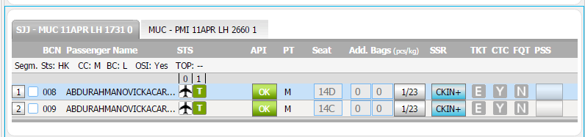
Tier 4 - IATCI - high level flow
Back to TOC
Airport workstation
Example: User checks in a passenger in SJJ. Passenger has an onward from MUC to PMI.
User checks in the SJJ flight. The command is sent to iPort via the network
Iport creates an XML call and sends it to Meridian via XMLe/MQ.
Meridian determines that an external IATCI needs to be issued and calls (in this case) Amadeus
Amadeus checks in the second flight and returns an IATCI message to Meridian
Meridian updates the segment status in the PNR and returns the response to iPort
Meridian sends the boardingpass data to the printer in SJJ (both the ‘local’ and the onward) and iPort send the response to the iPortFox client
iPortFox
network
Boardingpass print
Check-in
Atlanta Data Center
iPort application
iPort servers
XMLe
Meridian
network
Other
IATCI partners
Other
IATCI partners
Other
IATCI partners
1A
Other
IATCI partners

Slide 47
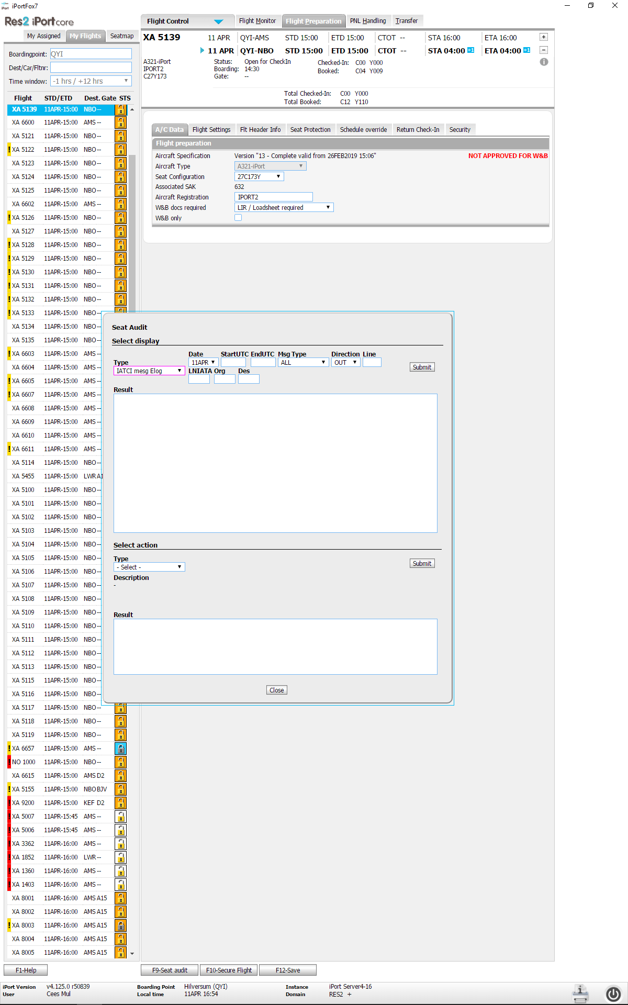
Tier 4 - IATCI outgoing
Back to TOC
IATCI is the capability to through check in on onward flights that are not necessarily handled in iPort. The message exchange is triggered on the conditions described below. All external IATCI processing is done in the IATA EDIFACT format. The conversations also allow seatmap displays, seat changes etc. All external IATCI messages are triggered by Meridian.
Travelport runs an ‘IATCI hub’. This is an application that processes IATCI messages for third parties as well.
An IATCI on a ‘local’ flight (handled in iPort) is triggered under the following conditions:
The PNL contains at least one onward flight (the flight is then created in the PNR).
Either:
The onward flight is also handled in iPort (‘in the box’ IATCI).
Or, the onward segment is handled in an external system, and an IATCI agreement for the airline exists in the system. This, in itself is not enough, since there also needs to be an IATCI connection defined with the relevant third party system.
Many of our IATCI’s are handled by Amadeus (1A). Main reason is that 1A is omnipresent and has a lot of airline customers.
The IATCI connection with 1A can be re-used, but new airlines need to be reported to the target system.
There are a number of IATCI calls possible: check-in, seatmap, change seat etc.
IATCI logging can be found in iPort (currently in seat audit):

Slide 48
Tier 4 - IATCI incoming
Back to TOC
iPort (actually Meridian) can also receive incoming IATCI calls. The logic is the same. Another DCS can determine that an onward flight is not handled in their own system but in iPort.
Such IATCI messages are received in the Travelport IATCI hub and sent to Meridian where the check-in (or other IATCI process) will be executed accordingly.
After processing, a return message will be sent to the caller.

Slide 49
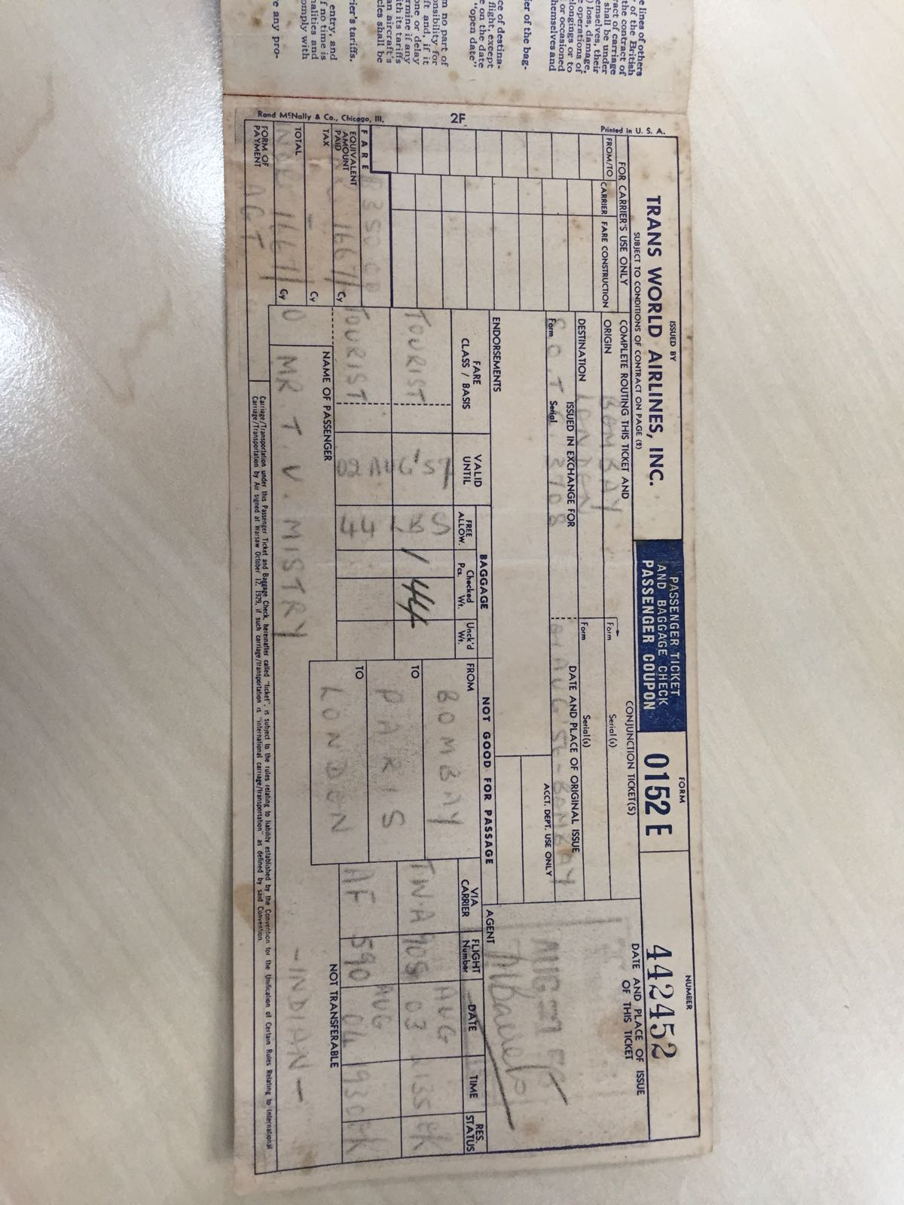
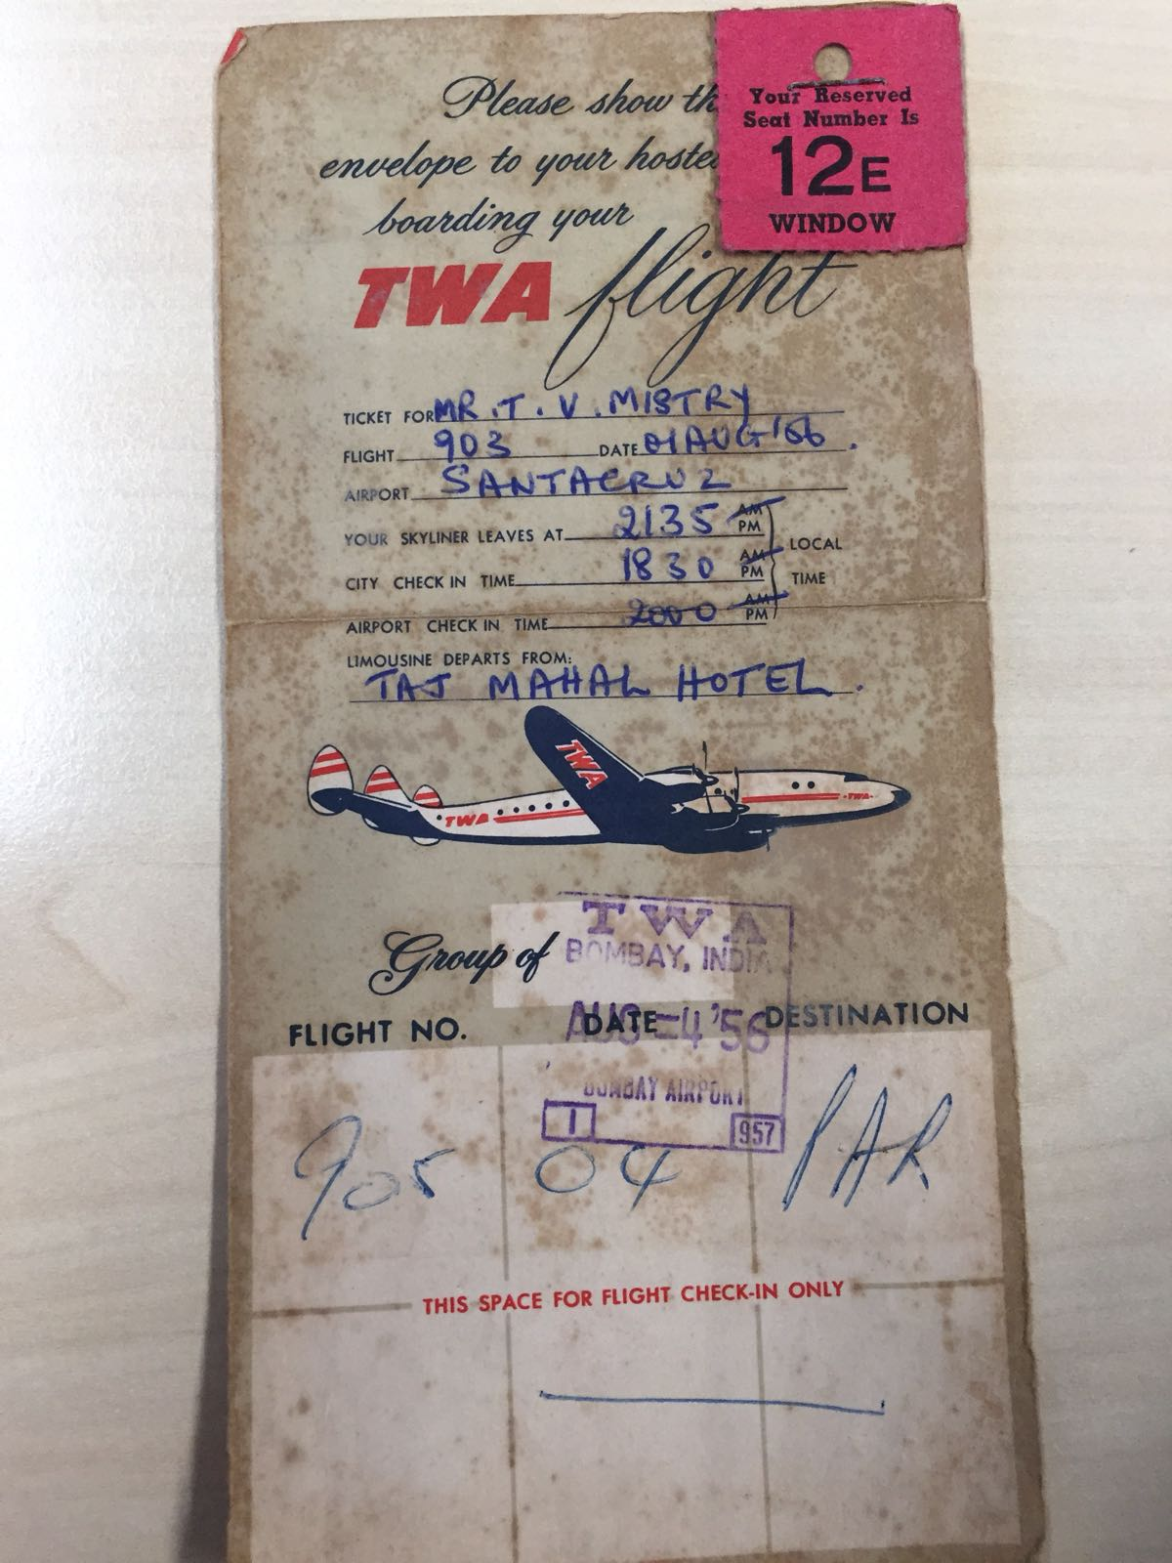
Tier 4 - E-ticketing
Back to TOC
An E-ticket is an electronic version of the former airline paper tickets. They were introduced sometime during the late 90’s. It is a value paper that is stored in an E-ticketing database.
All GDS’s and many airlines use E-tickets.
E-tickets can be used for itineraries that cover multiple airlines.
E-tickets cannot be lost.
The flight status can be maintained and viewed from many locations world wide.
Travelport
ET customer
Below is an example of an e-ticket associated with a passenger in a PNL
010 1BURROWS/ANDREWMR .L/BECIJL/JU .O/JU7727D16BEGTGD1925HK 011 .R/RQST HK1 2D-1BURROWS/ANDREWMR 012 .R/TKNE HK1 1152121113819/1-1BURROWS/ANDREWMR .R/DOCS HK1/P/GB/ 013 .RN/537318858/GB/18NOV77/M/02FEB24/BURROWS/ANDREW-1BURROWS
Amadeus ET database (ET Hub)
Travelport ET database (ET Hub)
1A ET customers
Travelport
ET customer
iPort
Travelport hosts airlines and other reservations systems in their ET hub.
The Travelport ETDB is connected to other ET hubs such as Amadeus.
This means, Amadeus hosted airlines ET tickets can be approached from iPort (via Meridian) using:
Interactive Ground Handling (changing the status of the e-ticket coupon to Checked-in and Lifted on the Operating carriers e-ticket database using industry standard Edifact messaging),
or Control Method Ground handling(Pulling control of the e-ticket coupon into the iPort database(XH) and changing the status internally, then once complete, return control of the coupon to the Operating Carrier’s E-ticket database(using Industry Standard Edifact Messaging)).

Slide 50
Tier 4 - Ticketless
Back to TOC
E-ticketing could be considered a ‘paperless’ ticket, although it can of course be printed.
The alternative for E-ticketing is ‘ticketless’. Low cost and leisure carriers usually do not use E-ticketing.
ET requires fairly advanced systems, and is mainly relevant when passengers are handled on behalf of other carriers, and are allowed to rebook/board other carriers.
Low cost and leisure airlines often send a confirmation, which may even contain a number which can be considered a booking number. So, ticketless, is not really ticketless, it just means there is no formal IATA ticket involved.

Slide 51
Tier 4 - Baggage processing
Back to TOC
When passengers bring baggage on board, the system creates a baggage label. This baggage label has a number. The baggage label numbers are generated by Meridian. The printer data is formatted and sent to the baggage label printer.
At the same time a BSM or BTM message is generated.
Airport operational systems involved in handling baggage:
Baggage Sortation Systems (or Baggage Handling System)
Explained in some more detail on next pages
Baggage Reconciliation Systems
Explained in some more detail on next pages
Message types involved:
BSM
Baggage Source Message. IATA standard message that contains baggage number, flt data, pax data etc. There are BSM ADD and BSM delete messages. A BSM is issued by a DCS and is generated for every piece of baggage that is checked in.
BTM
Baggage Transfer Message. IATA standard message. Similar to BSM, but is sent to onward airport to inform the baggage systems about the expected transfer baggage.
BPM
Baggage processed message. This is a message sent from the Baggage reconciliation system TO the DCS.

Slide 52
Tier 4 - Baggage Sortation Systems
Back to TOC
A baggage sortation system scans the barcode on the baggage label (or a chip that is associated with the label), and directs the baggage to the correct location.
The baggage data is stored in the BHS database and is fed by BSM/BTM messages.
There is a variety of Baggage Sortation Systems, but SITA is (again) one of the major players in this field.
To be able to sort the bags, the Baggage Sortation System requires all baggage data from all the handling DCS’s.
‘Local’ baggage is sent via BSM’s by all active DCS’s.
Incoming baggage is sent via BTM from the previous/upline stations by the DCS that is active on the local station.

Slide 53
Tier 4 - Baggage Reconcilliation Systems
Back to TOC
A BRS is used to load the baggage on an aircraft.
The BRS is also fed by BSM and BTM messages.
It has stored all baggage data in its database (gathered by receiving the BSM/BTM’s). The baggage loaders scan the barcode on the baggage label, which registers that the bag is loaded, and if possible registers in which hold the baggage is loaded. This allows the loaders to check if all bags are loaded or to see which ones are missing.
The alternative is manual checking. In that case the baggage stubs are used and compared to a printed list of baggage (the bingo sheet).
Optionally, the BRS can send a BPM message to the DCS to inform the system that a piece of baggage was loaded. This can be useful information for the groundhandler working at the gate or possibly for the passenger
Multiple providers of BRS systems exist. And sometimes it is sold as part of a DCS. iPort does not have a BRS module, but at a number of airports, we cooperate with Travsys. A small Dutch company specialized in airline IT

Slide 54
Tier 4 - Baggage processing iPort specific
Back to TOC
Baggage messages are usually generated by Meridian. Set up is done in the 4BTU table (screen print below)
If a baggage item is added or changed, Meridian will format a baggage message and send it via the symbolic address as defined in the 4BTU tables.
>*************** STATION ADDRESSES FOR AMS ********************** OPTION CODE -- C/CONFIRM - P/PRINT - E/EXIT - H/HELP >4BMASK PRINTER ADDR(......) ROTARY(.) ITEM 001 TO 003 OF 003 MSG-TP(BSM) DT(30SEP13) ALC(XH) VS(01) ACK(N) ADDR-TP(M) ADDR (1) (AMSBSXH/......./......./......./......./.......) MSG-TP(BTM) DT(25NOV15) ALC(KL) VS(1 ) ACK(N) ADDR-TP(M) ADDR (1) (HDQKMKL/......./......./......./......./.......) MSG-TP(BTM) DT(27JUL17) ALC(XA) VS(1 ) ACK(N) ADDR-TP(M) ADDR (1) (UTCPS1P/......./......./......./......./.......) SCROLL CMD(..) OPTION(.) ----------------------------------------------------------------
Please add a piece of baggage
iPort application
SITA baggage hub or direct delivery
Please add a piece of baggage
XMLe
Airports
Baggage systems
OK, baggage added
Meridian
Send BSM message to the airport
network
Atlanta Data Center
The SITA baggage hub in London plays a big role in delivering baggage messages over the world. We have a direct MQ connection with SITA hub in London. Most SITA airports are connected to the SITA hub, and they function as a focal point for baggage data. This means we can route all SITA related BSM’s to a single address (STABSXH), and SITA will forward based on airport code.
The SITA MQ connection to the baggage hub is using the SITA routers in Atlanta.

Slide 55
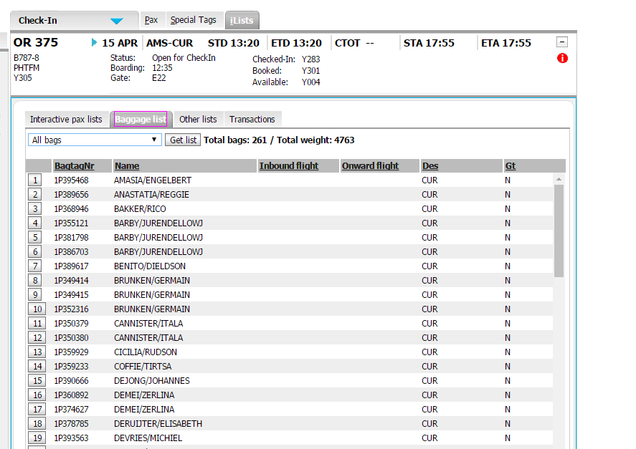
Tier 4 - Baggage processing iPort specific
Back to TOC
iPort supports a large number of baggage lists.
Baggage numbers can either be generated via iPort, via the kiosk or via a bagdrop device. In all situations, Meridian issues the numbers.
Example of a baggage list in iPort.

Slide 56
Tier 4 - Security Messaging - introduction
Back to TOC
Increasingly, governments demand Passenger information from flights coming in and departing their country. The industry has defined a number of passenger information messages:
Advance Passenger Information (API) for passengers travelling to or from a specific country. This is driven by security concerns. API data is a subset of the data found in a passport.
API data is either collected by the reservations system or by the DCS. In some cases, iPort receives the data from the reservations system (in the PNL). In most cases the data is gathered at the airport by means of a passport scan.
PNRGOV. This is a dataset that exceeds the passport data content. It includes for example home address or street address of the passenger in the destination country. It may also hold other personal data.

Slide 57

Tier 4 – APIS Security Messaging – Batch vs interactive
Back to TOC
Batch
In most cases, API data is delivered via ‘batch’ messages.
A store and forward, usually via TTY that sends all the passport data for a flight to the destination government system.
This batch is sent at the time of flight departure (set the flight to Post Departure) when all passenger data is definite.
Some countries demand batch data x hours before departure. In practice this means that multiple API messages per flight are sometimes sent.
Batch API messages are partially built by Meridian and partially built by iPort (using XMLe).
Interactive
Increasingly, governments demand ‘interactive’ vetting of passport data.
This means, a connection between the DCS and the government instance needs to be in place.
When the agent scans the passport, the data is immediately sent to the government, which responds with a ‘allowed’ or ‘not allowed’ response.
This mechanism is usually referred to as Interactive API or iAPI.
Indirect (via Service provider)
Batch
Batch
Government agencies
Scan
DCS (iPort + Meridian)
Government agencies
Government agencies
Interactive
Interactive
Government agencies
Government agencies
Batch - direct
Reservations system
PNL
Interactive - direct

Slide 58
Tier 4 - APIS – Interactive Interfaces
Back to TOC
Although the content of the security messages usually adheres to IATA standards (for the most part…), the delivery mechanism itself can vary widely, depending on which government instance is involved. This is particularly true for the interactive type of messaging. Currently supported countries in iPort:
Country | Delivery method | Status | Comment
Canada | Via SITA | Operational | Not used due to demise of WOW air
China | Direct via HTH Matip | Under construction | VJ driven
Korea (South) | Via Arinc HTH Matip | Operational (one way) | VJ driven
Myanmar | Via SITA | Operational
Oman | Via SITA | Operational
Qatar | Via SITA | Operational
Saudi Arabia | Via SITA | Operational
Taiwan | Via Arinc HTH Matip | Operational (one way) | VJ driven
Thailand | Via SITA | Operational
UAE | Via SITA | Operational
United Kingdom | Direct via MQ | Operational
USA | Direct via Meridian | Operational
Adding countries to iPort always requires some development. A number of factors determine the lapse time:
Determining the delivery method (direct, or via Sita or Arinc). Sita offers a ‘Government gateway’ and Arinc offers their ‘ABMS’ (Arinc Boarder Control System).
Contractual considerations (costs!).
The technical side of setting up a connection (the project).
Connecting via one of the main providers is theoretically easier to achieve, but there is sometimes a high price to pay.
The exact lay out of the messages that may or may not be an interpretation of the IATA standard, but usually deviate slightly.
Res2 developed a flexible way to connect to the growing number of countries that demand interactive vetting.

Slide 59
Tier 4 - APIS – Interactive in detail
Back to TOC
1-user swipes passport
User swipes passport (iPortFox)
Iport reads passport data
calls XMLe service APIUPDATE (XML format)
Format EDIfact message or SITA GG command
Send formatted message via HTH
HTH sends message via MQ, MATIP or SITA GG
Process request at countries’ specific vetting system
Return message via HTH
XMLe-interpret response/update PNR
Return XMLe response to iPort (XML format)
iPort- send response to end user
iPort
TPF
2-iPort
4-XMle
3-MQ cluster
5-XMLe
9-XMLe
11-iPort
6-HTH
8-HTH
10-MQ cluster
MQ, MATIP or SITA GG
Optional: ABMS or SITA GG
Specific country

Slide 60
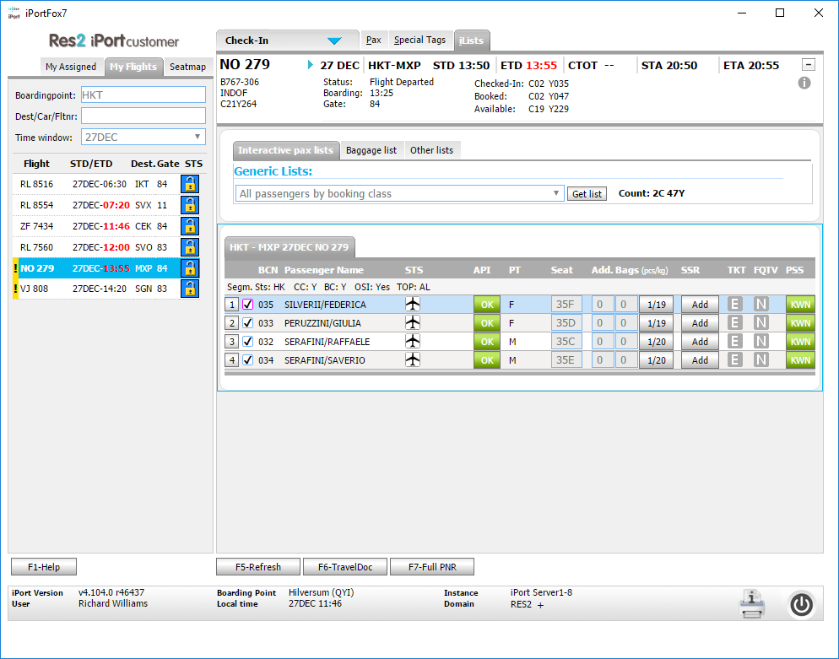
Tier 4 - APIS – example iPort screen
Back to TOC
On this slide a flight from Thailand to Italy is shown. Both API and PSS button are in use, since interactive APIS is demanded by Thailand, both inbound and outbound.
APIS buttons indicate if API data is filled in.
PSS KWN and green indicates that the vetting for those passengers was successful.
The fact that Thailand demands APIS is set up in Meridian and in iPort. Various settings exist.
Adding countries to the interactive API landscape usually involves some software development.

Slide 61
Tier 4 – Security messaging - PNRGOV
Back to TOC
PNRGOV was initiated by governments to further improve insight into which people are visiting their country. It improves their capability to monitor e.g. trends in payment by an individual.
iPort specific considerations
Usually, the PNRGOV data is sent by the reservations system.A reservations system holds more personal information than a DCS. So, iPort normally is not used to send PNRGOV data.
The only exception to the rule in the iPort environment is VietJet. We have agreed that PNRGOV for Vietjet is sent by iPort. Actually it is Meridian that formats the message, but for an end user that is transparent.

